Slide 1

Trust in science and science-related populism:
Implications for the role of science in politics and society
Viktoria Cologna¹ & Niels G. Mede²
¹Department of the History of Science, Harvard University, United States – e-mail: viktoriacologna@fas.harvard.edu, Twitter: @colognav
²Department of Communication and Media Research (IKMZ), U of Zurich, Switzerland – e-mail: n.mede@ikmz.uzh.ch, Twitter: @nielsmede

Slide 2
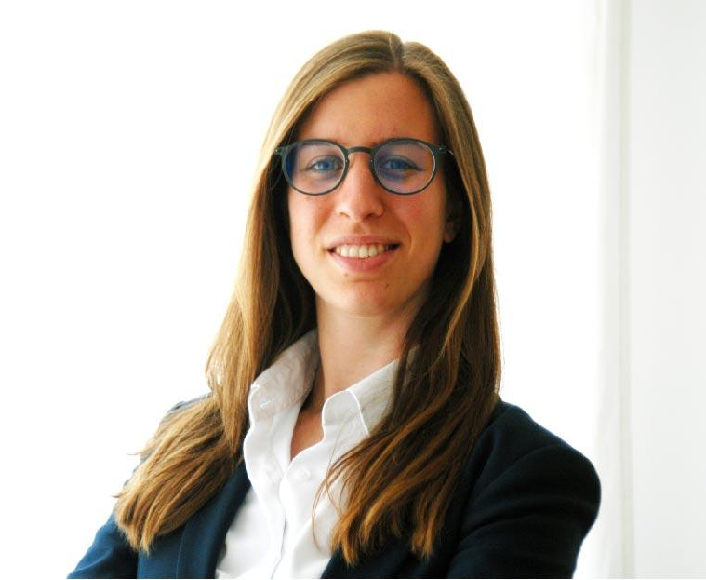
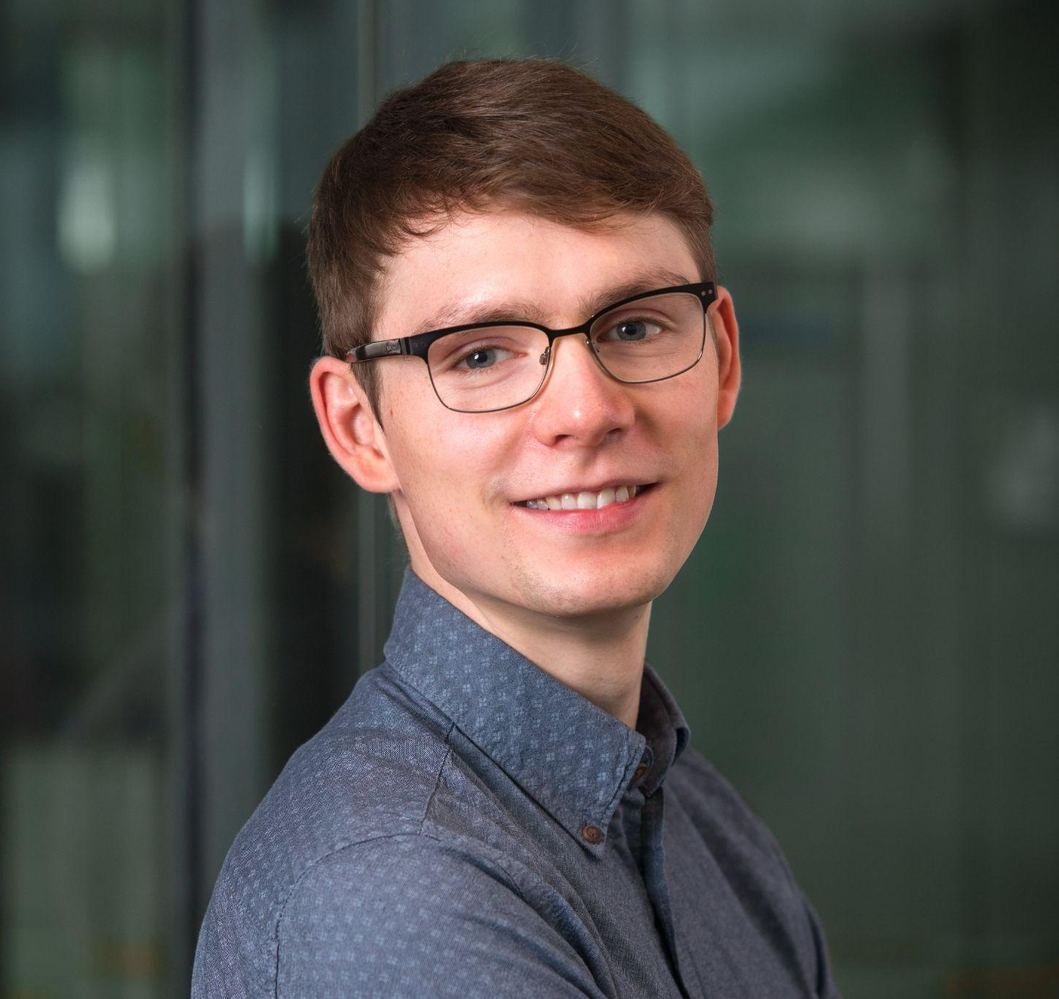
Science communication
Psychology of trust in science
Science in society and policy-making
Science communication
Science-related populism
Public perceptions of science
Notes:
Change order

Slide 3
Overview
Introduction
Trust in climate science
Science-related populism
International study on trust in science and science-related populism
Discussion: implications of trust and populism
Q&A

Slide 4
Definition of trust
Trust is “a psychological state comprising the intention to accept vulnerability based upon positive expectations of the intentions or behaviour of another” (Rousseau et al., 1998, p. 395)
Trust in others reduces the risk of having to rely on the unknown and enables us to benefit from the expertise of others (Goodwin & Dahlstrom, 2014)
Trust is essential in navigating the complexity of modern societies (Luhmann, 1989).
Trust is based on the judgments of similarities in intentions and values (Earle et al., 2007; Visschers et al., 2011)
Notes:
We already know that trust and distrust are cognitive and affective notions that become particularly relevant in conditions of risk or uncertainty (Levi, 1997; Fenton, 2000). In this context, trust can help us to make decisions by reducing the complexity of weighing different risks and benefits, especially when information is not readily available. Given the uncertainties and large-scale risks surrounding climate change, trust is essential to help us navigate and reduce these complexities.

Slide 5

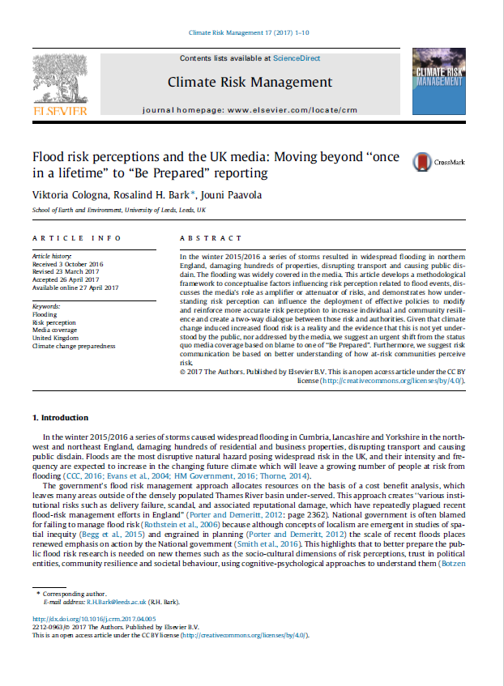
Why study trust (in science)?
Can serve as a heuristic in decision-making, thereby helping individuals make decisions in complex environments (Earle, 2010; Siegrist, 2021)
Understand societal legitimization of science and science-based policy-making
Cologna, V. et al. (2017). Flood risk perceptions and the UK media: Moving beyond “once in a lifetime” to “Be Prepared” reporting. Climate Risk Management, 17, 1–10. https://doi.org/10.1016/j.crm.2017.04.005
Notes:
We already know that trust and distrust are cognitive and affective notions that become particularly relevant in conditions of risk or uncertainty (Levi, 1997; Fenton, 2000). In this context, trust can help us to make decisions by reducing the complexity of weighing different risks and benefits, especially when information is not readily available. Given the uncertainties and large-scale risks surrounding climate change, trust is essential to help us navigate and reduce these complexities.

Slide 6
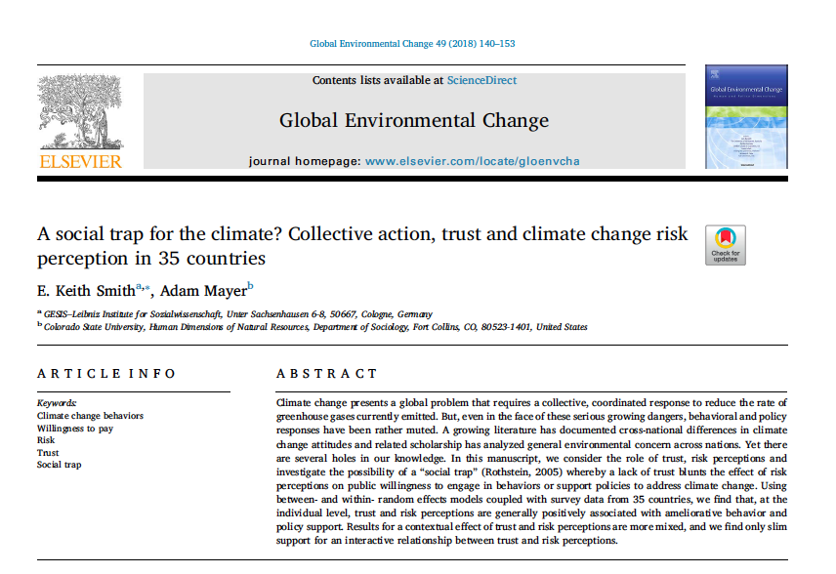
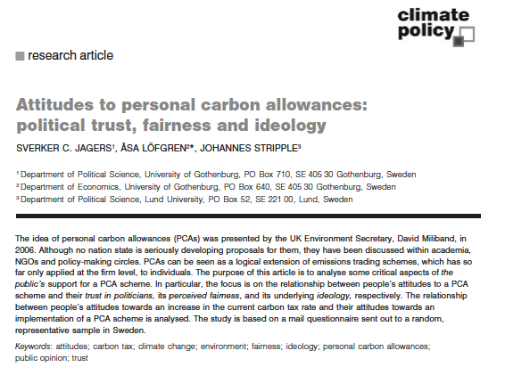
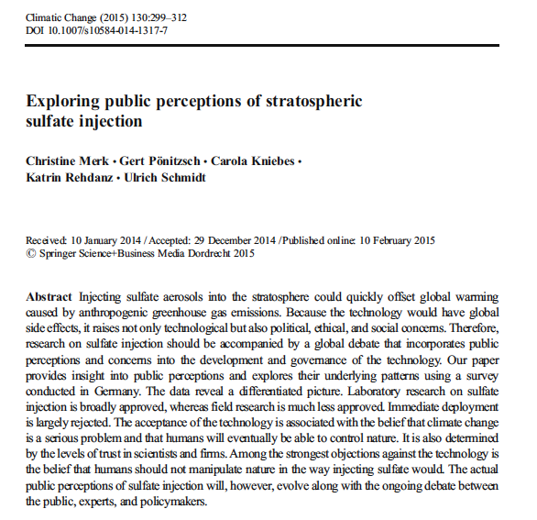
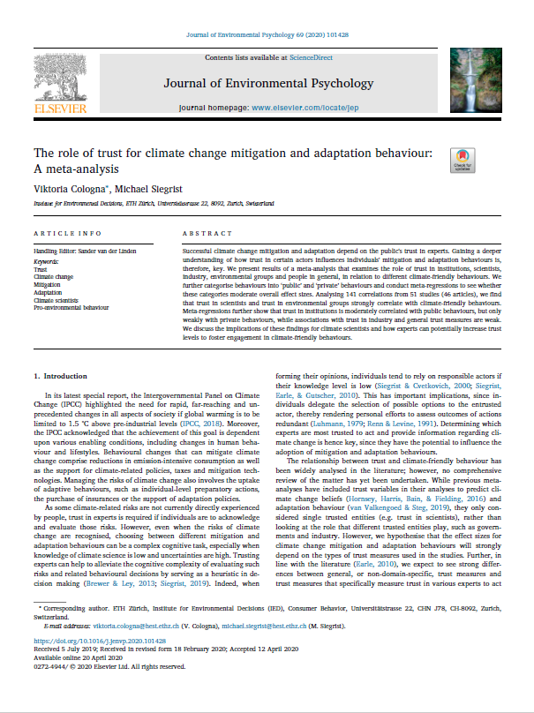
The role of trust for climate change mitigation and adaptation behaviour: A meta-analysis
Question: How strong is the role of trust (in different actors) for the uptake of climate change mitigation and adaptation behaviours across studies?
Cologna, V. & Siegrist, M. (2020) The role of trust for climate change mitigation and adaptation behaviour: A meta-analysis. Journal of Environmental Psychology, 69, 101428.
https://doi.org/10.1016/j.jenvp.2020.101428

Slide 7
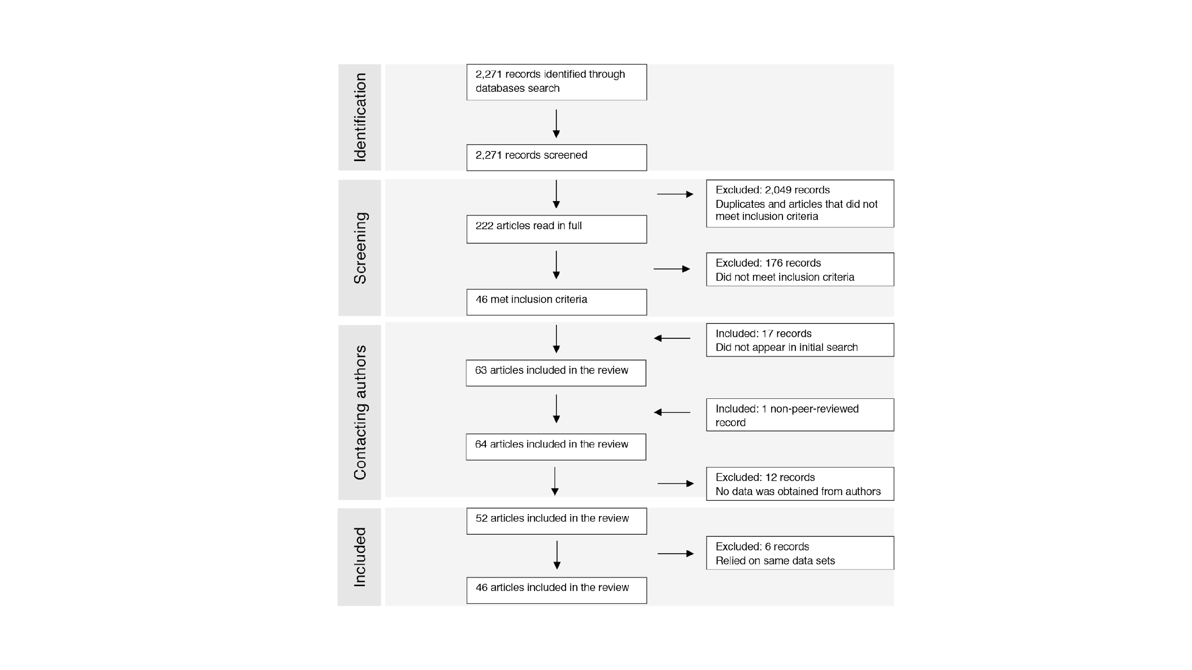
Literature review

Slide 8
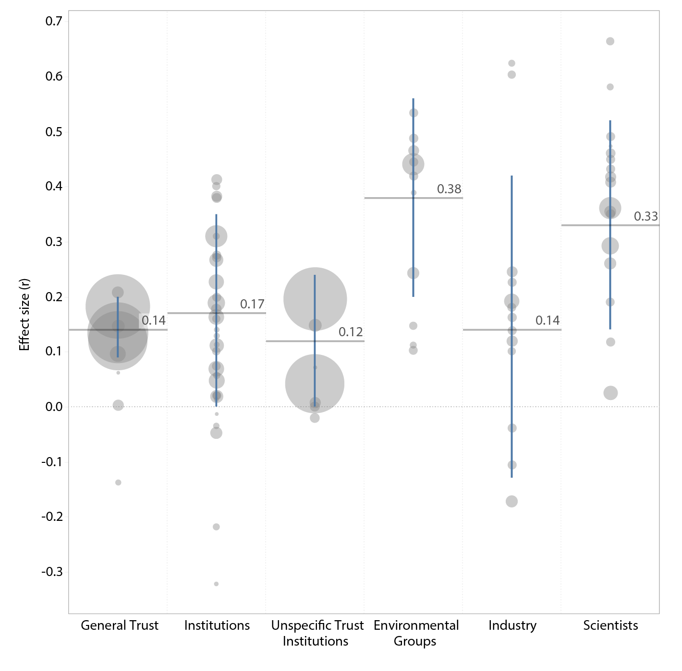
Results

Slide 9
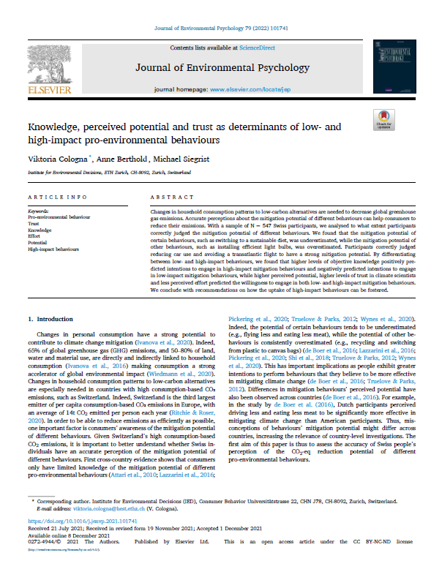
Trust in climate scientists predicts pro-environmental behavior
Question: What types of pro-environmental behaviors are predicted by trust in climate scientists?
Results:
Trust in climate scientists predicts both low- and high-impact pro-environmental behaviors
Cologna, V., et al. (2022). Knowledge, perceived potential and trust as determinants of low- and high-impact pro-environmental behaviours. Journal of Environmental Psychology, 79, 101741. https://doi.org/10.1016/j.jenvp.2021.101741

Slide 10
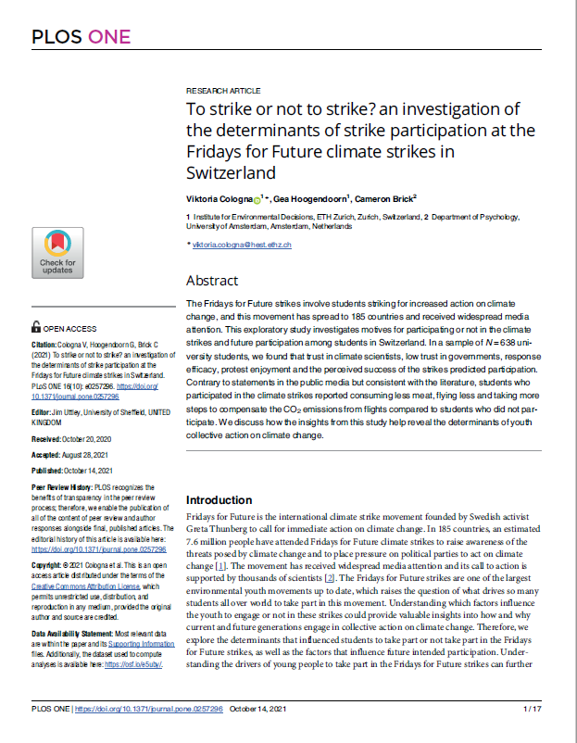
Trust in climate scientists predicts pro-environmental behavior
Question: What types of pro-environmental behaviors are predicted by trust in climate scientists?
Results:
Trust in climate scientists predicts both low- and high-impact pro-environmental behaviors
Trust in climate scientists not only predicts individual but also collective action on climate change, such as joining Fridays for Future protest
Cologna, V., et al. (2021). To strike or not to strike? An investigation of the determinants of strike participation at the Fridays for Future climate strikes in Switzerland. PLOS ONE, 16(10), e0257296. https://doi.org/10.1371/journal.pone.0257296

Slide 11
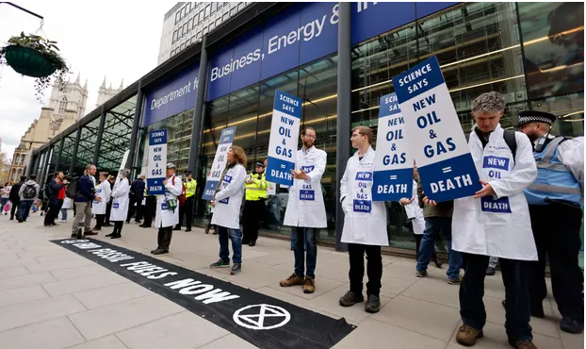
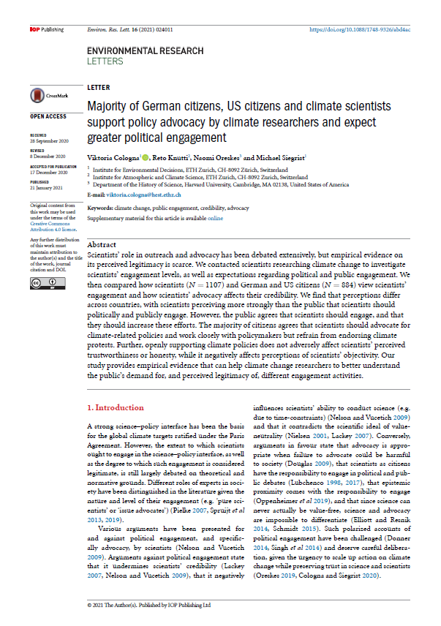
Perceived legitimacy of climate scientists in policymaking
Cologna, V. et al. (2021). Majority of German citizens, US citizens and climate scientists support policy advocacy by climate researchers and expect greater political engagement. Environmental Research Letters, 16(2), 024011. https://doi.org/10.1088/1748-9326/abd4ac

Slide 12

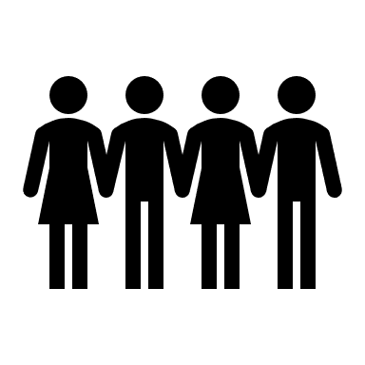



Perceived legitimacy of climate scientists in policymaking

Slide 13
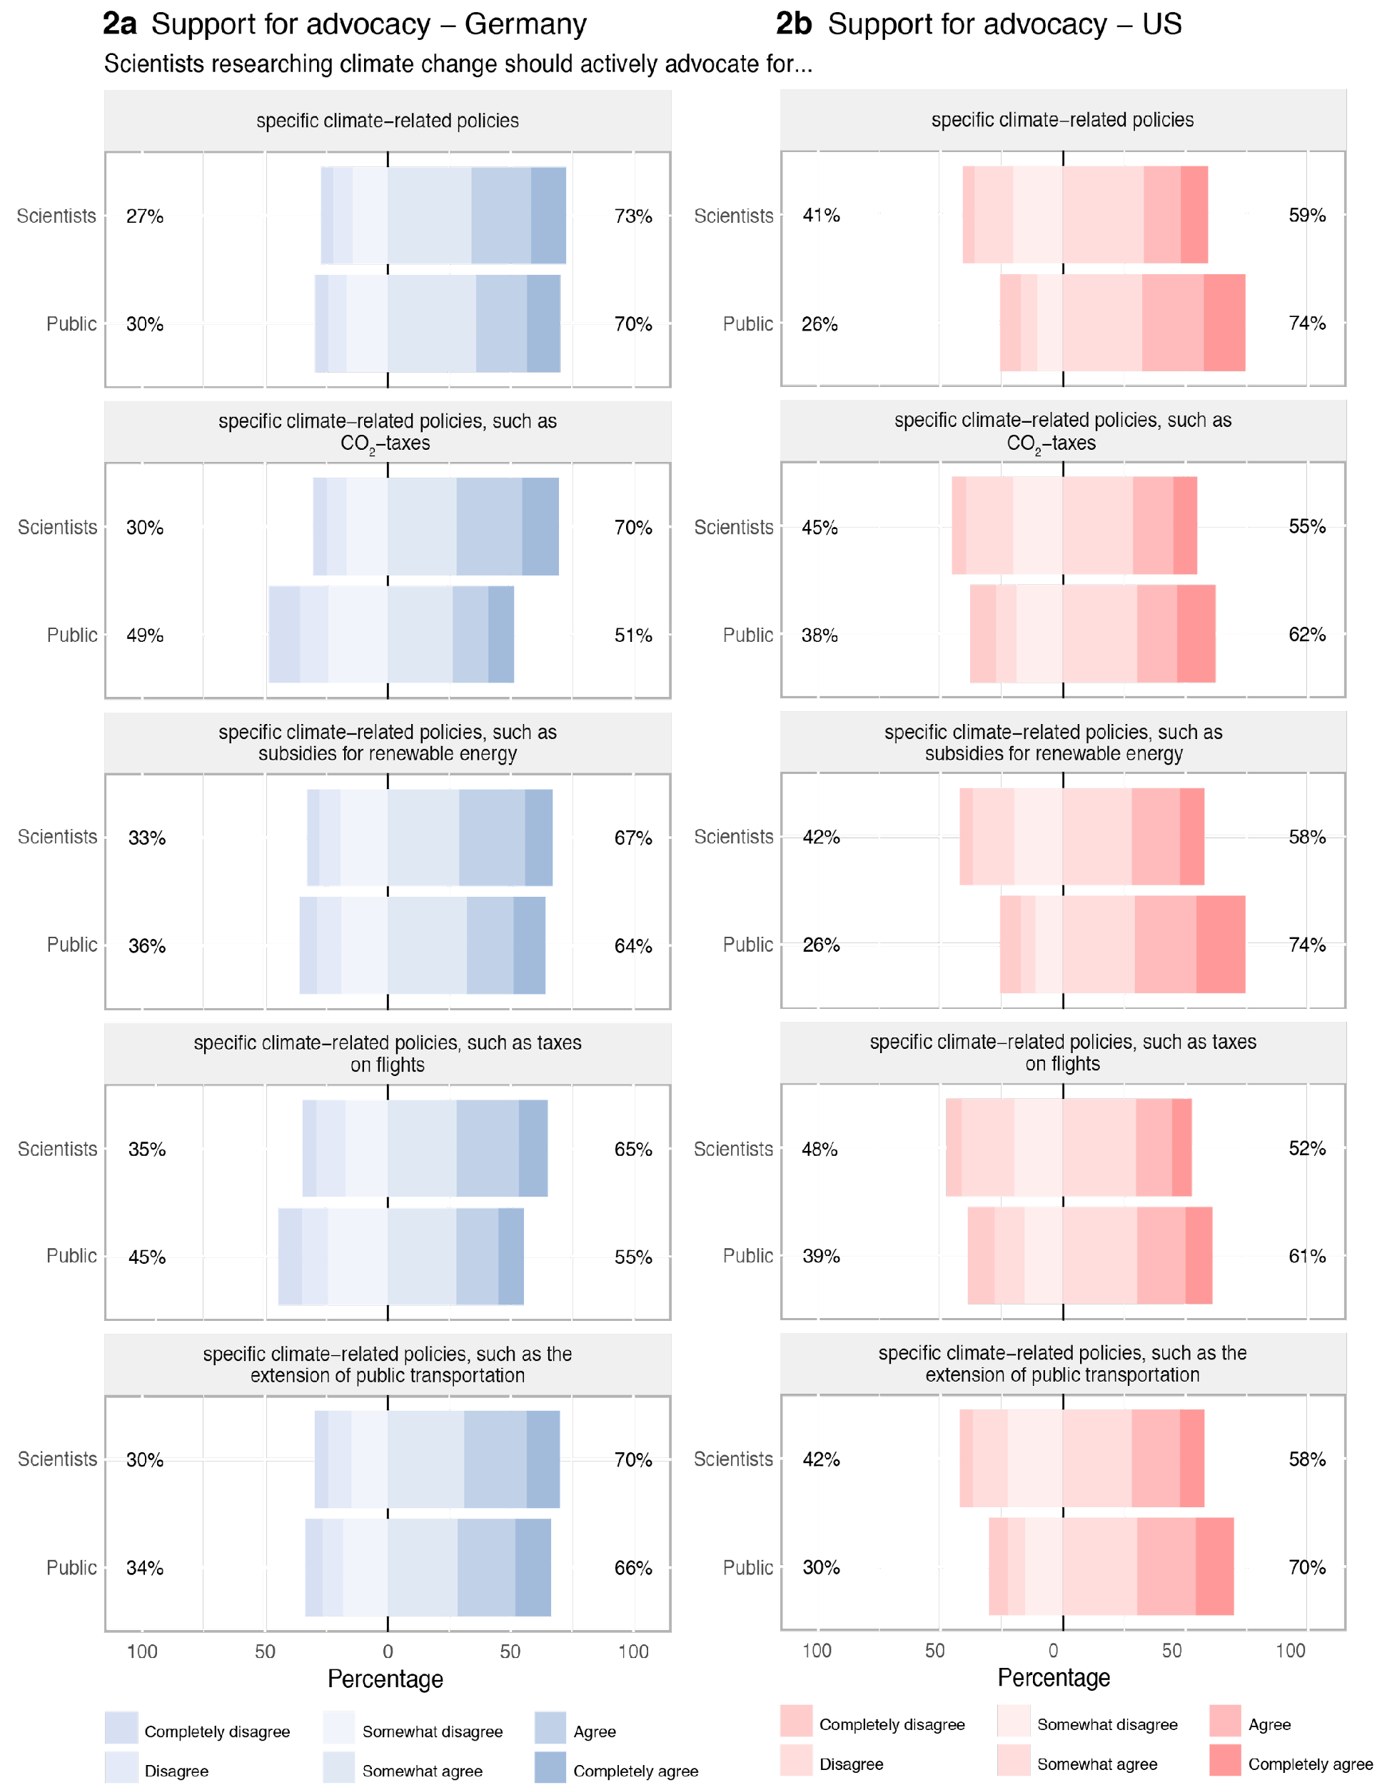

Slide 14
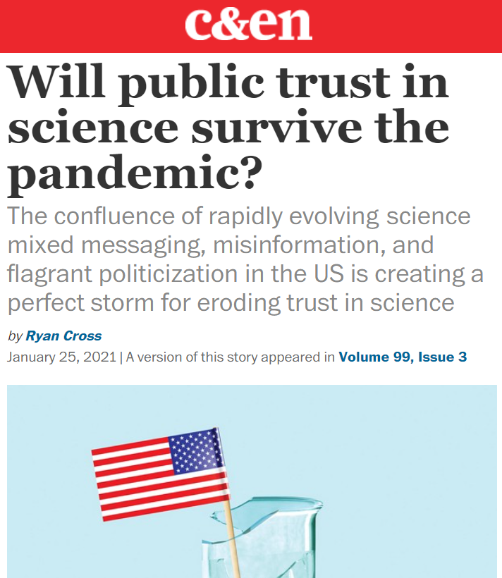
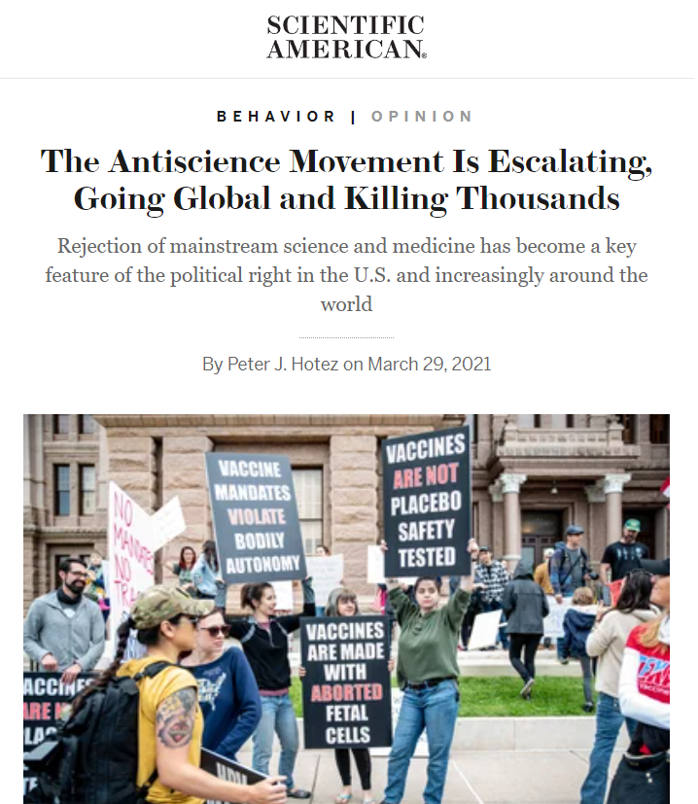
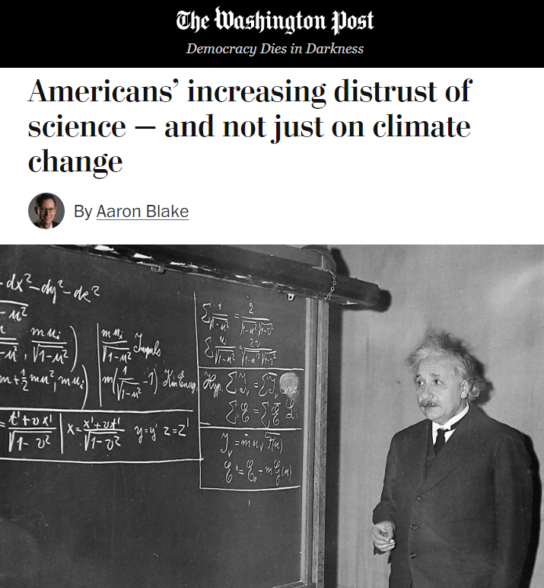
Criticism, skepticism, and distrust of science
Notes:
Journalists and scholars have voiced concerns about negative public attitudes toward science, scientists, and their knowledge, methods, and (assumed) influence in political decision-making
Some pundits suggest that these attitudes have even increased recently

Slide 15
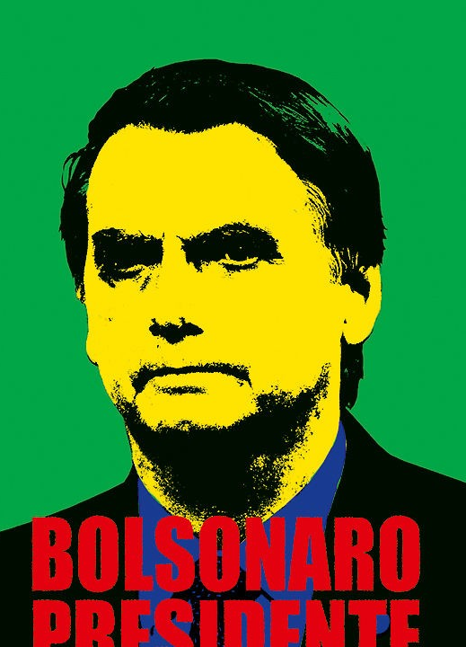
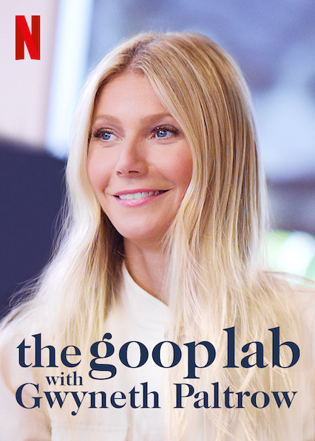
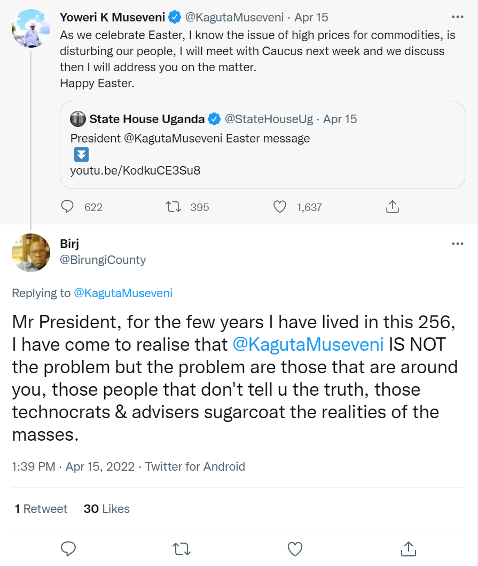
Criticism, skepticism, and distrust of science
US: 48% agree that “ordinary people are perfectly capable of deciding for themselves what is true and what is not” (Oliver & Wood, 2018)
Belgium: 42% believe that “people who have studied for a long time and have many diplomas do not really know what makes the world go round” (Elchardus & Spruyt, 2016)
Germany: 33% think that “people should rely more on common sense and less on scientific studies”
(Science Barometer Germany, 2019)
Romania: 15% strongly agree that one should rather “trust in the wisdom of ordinary people than the opinions of experts” (Bertsou & Caramani, 2022)
Notes:
Many of these concerns refer to anecdotal observations:
Anti-scientific claims of politicians with many voters
Pseudoscientific ideas in entertainment media with big audiences
Conspiracy theories and mis/disinfo spread by social media users with larger followership
But some concerns are also based on empirical research:

Slide 16
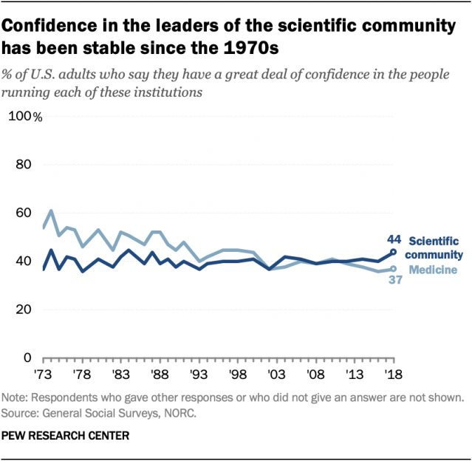
Criticism, skepticism, and distrust of science
However:
Little evidence that critical attitudes toward science have increased (Funk & Kennedy, 2020)

Slide 17
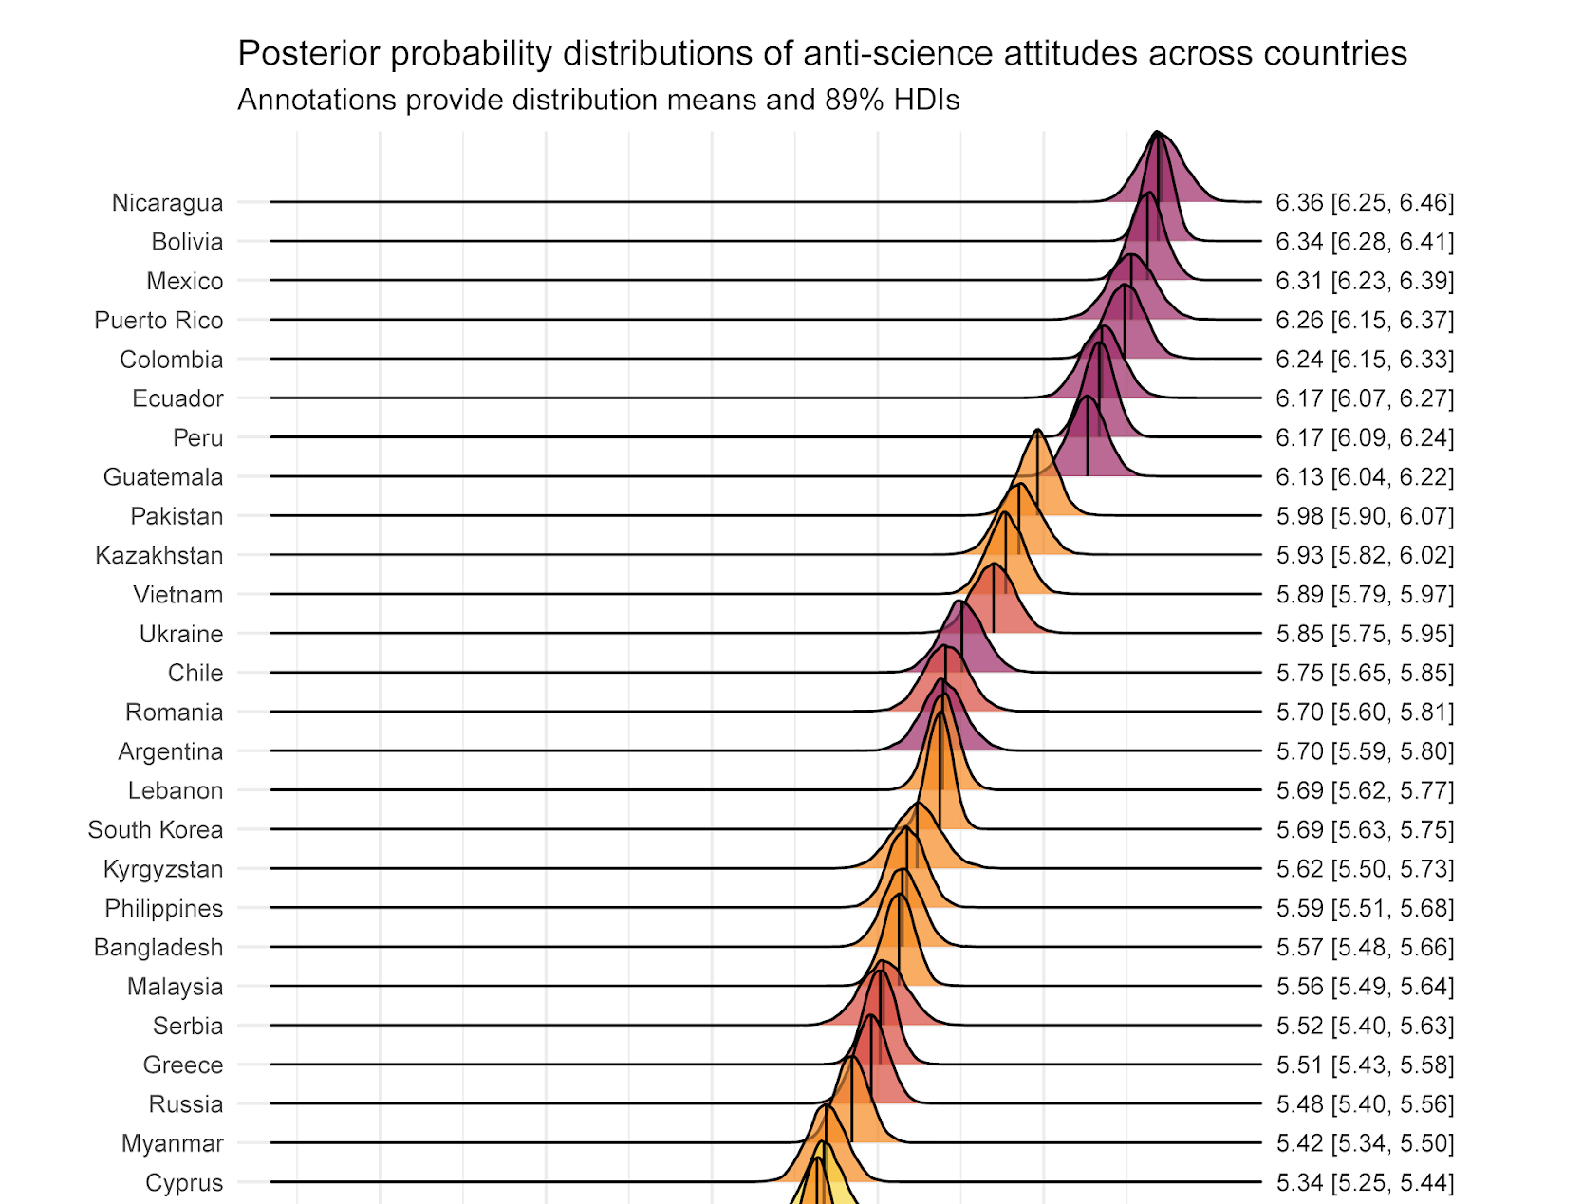
Criticism, skepticism, and distrust of science
However:
Little evidence that critical attitudes toward science have increased (Funk & Kennedy, 2020)
Critical science attitudes vary across topics, reference
objects, and countries
(Achterberg et al., 2017; Mede, 2022;
Rutjens et al., 2018)

Slide 18
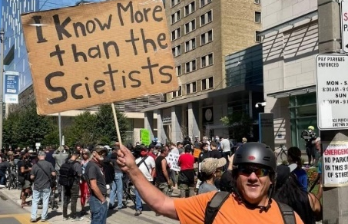
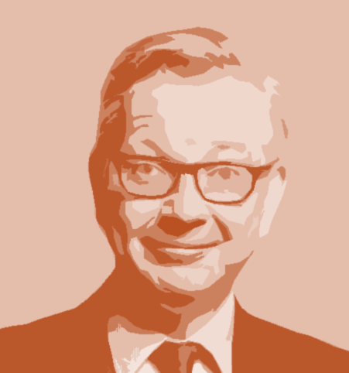
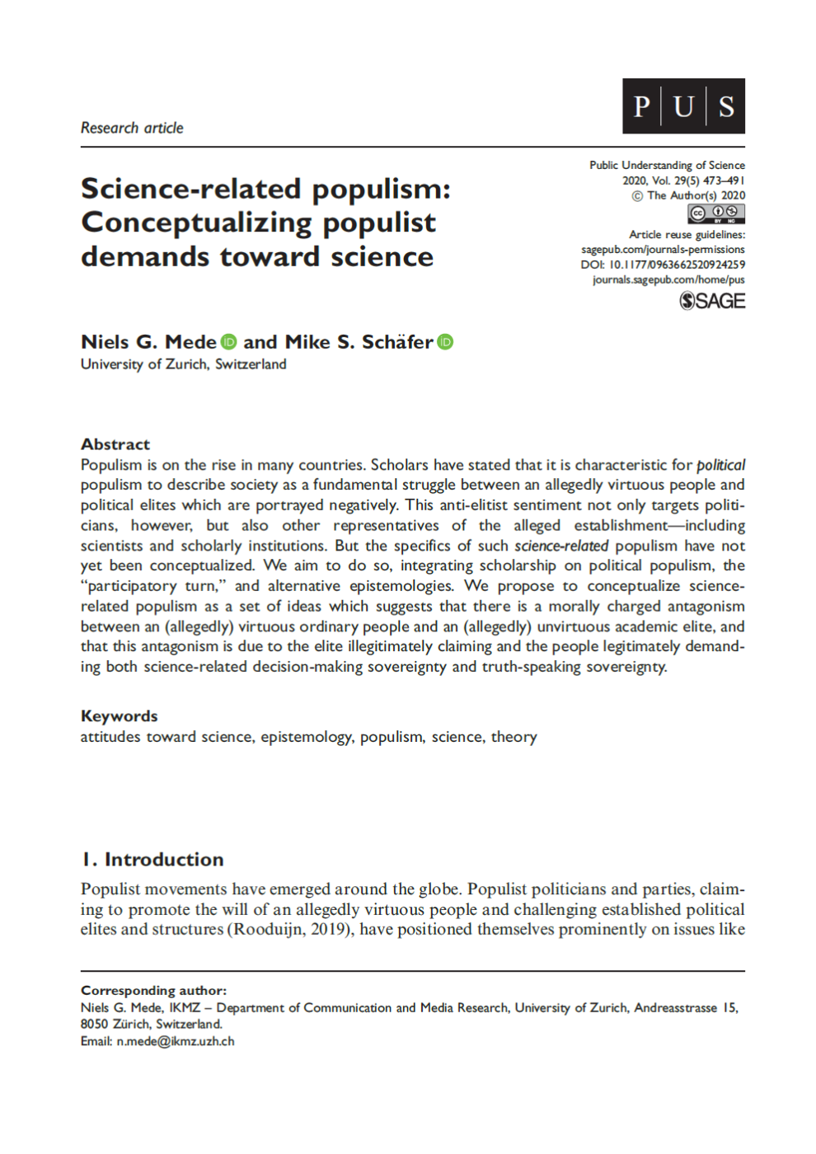
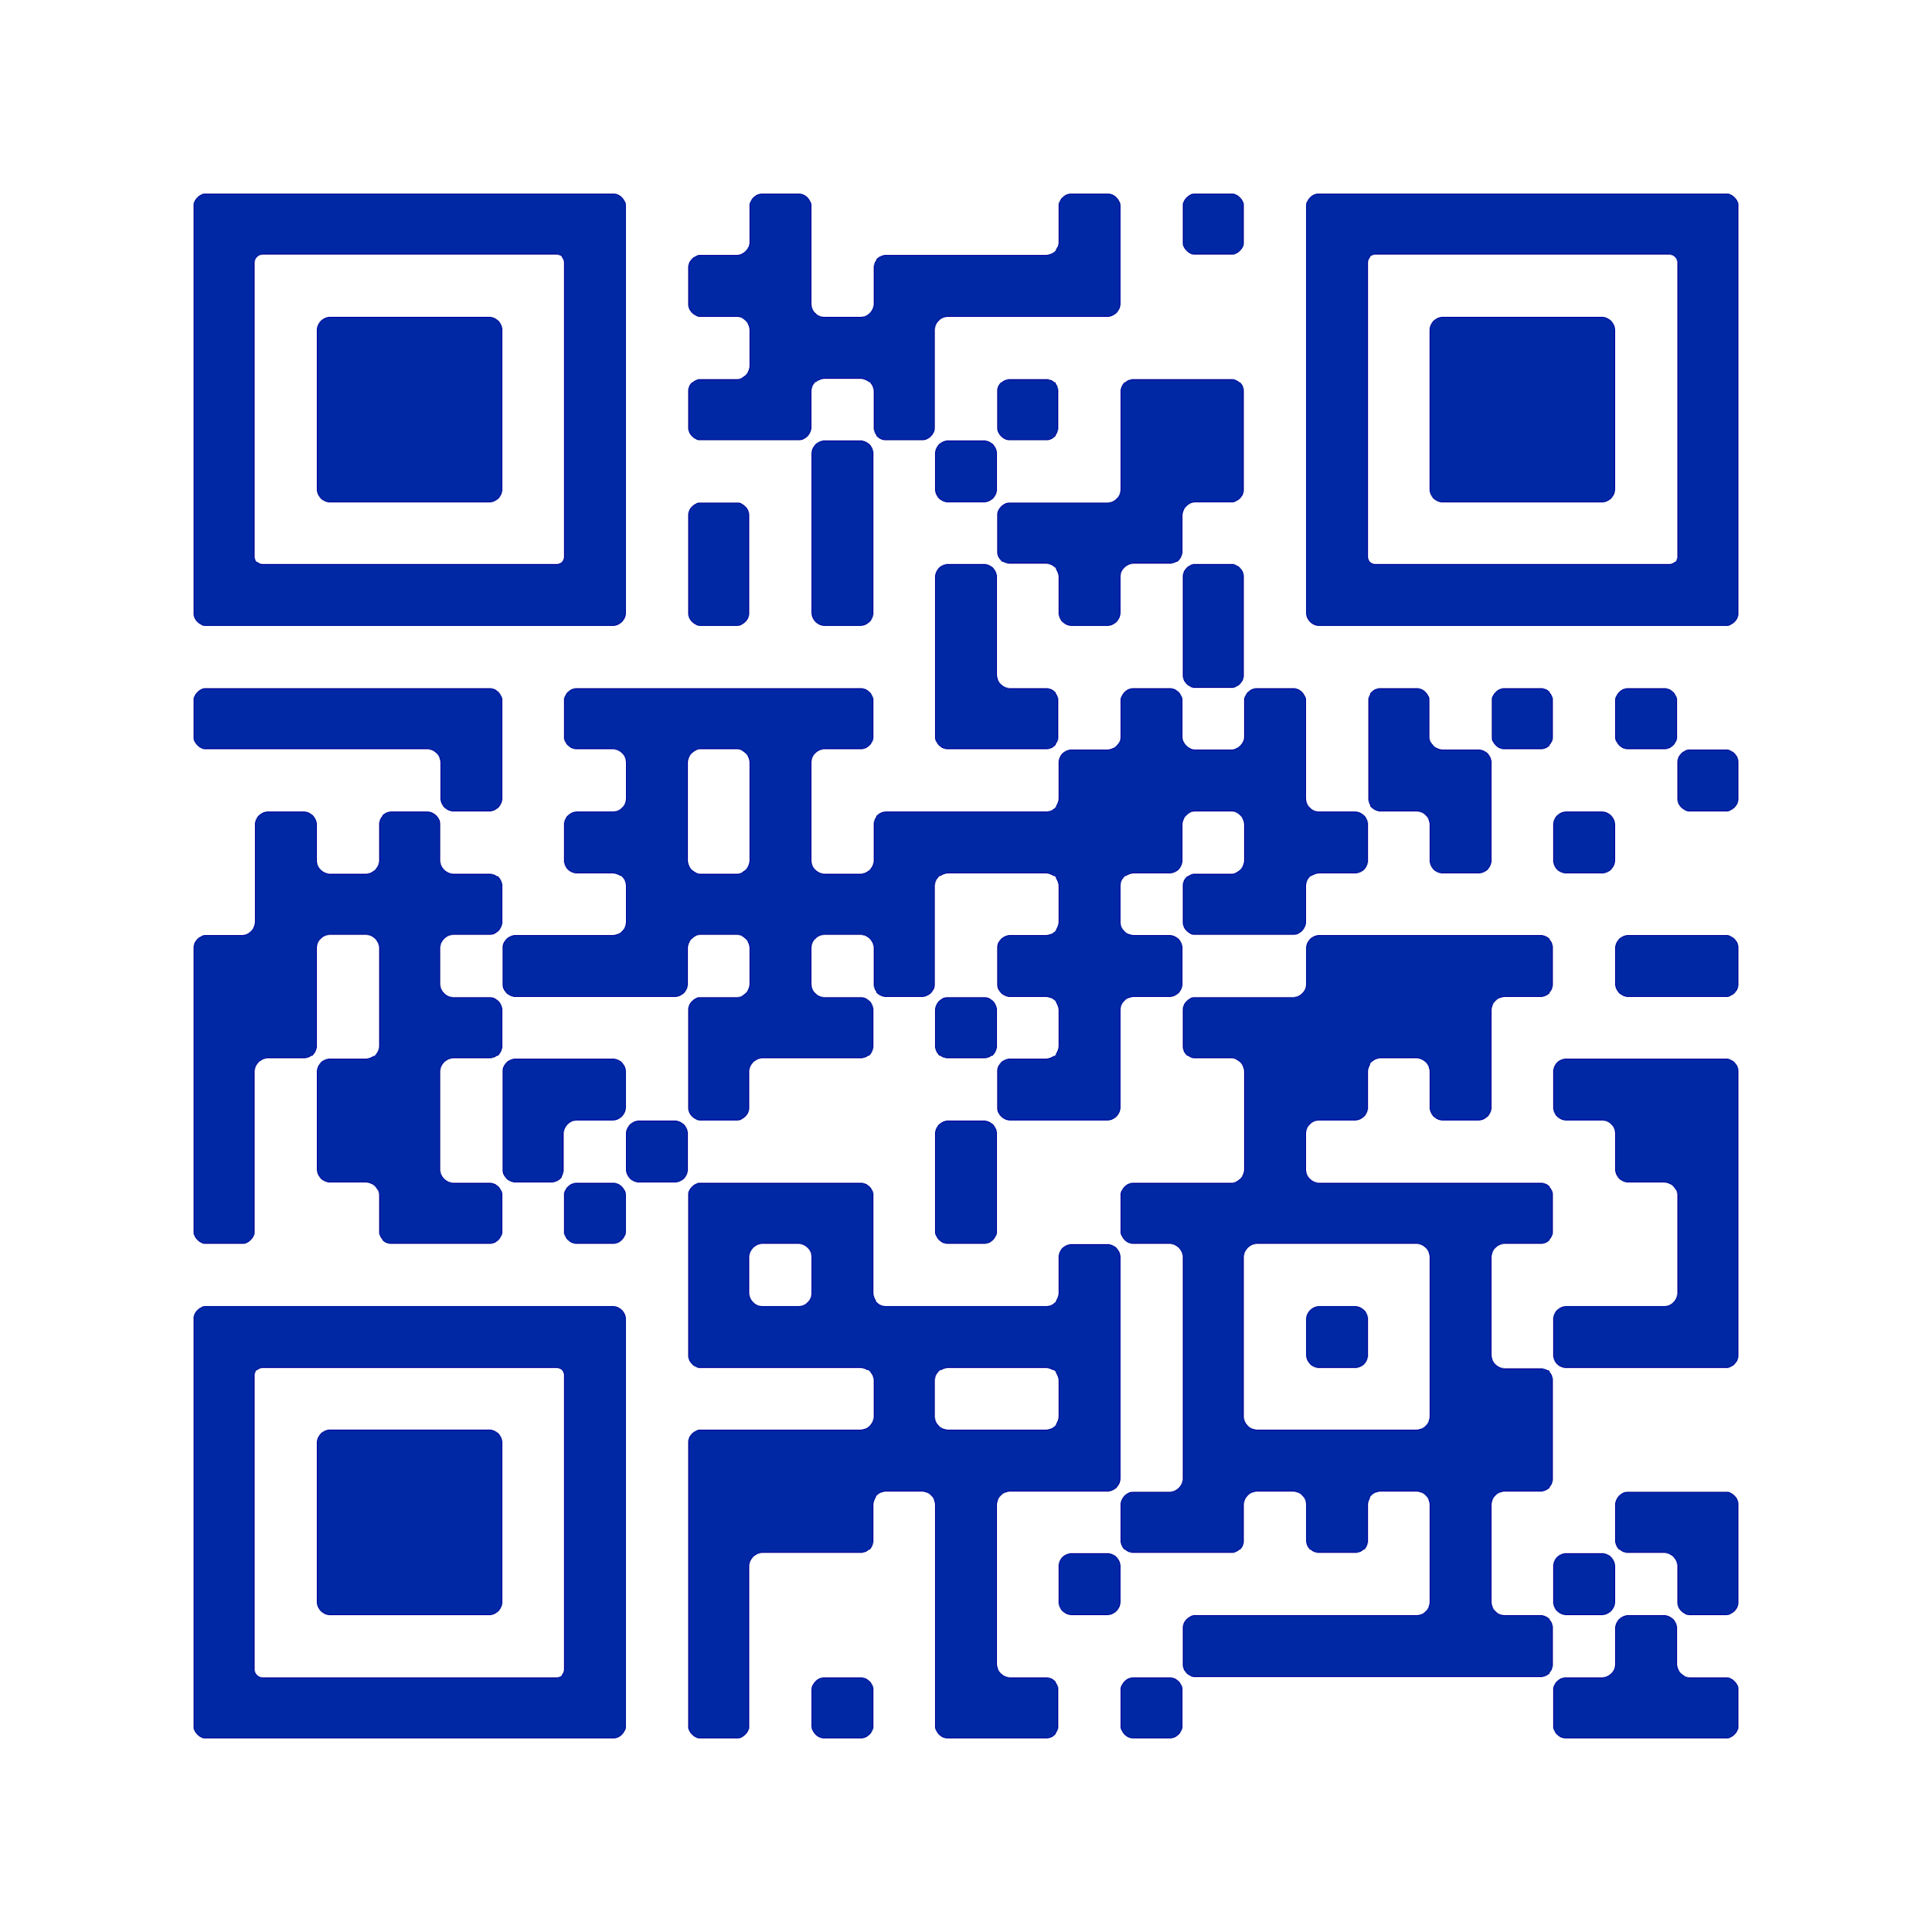
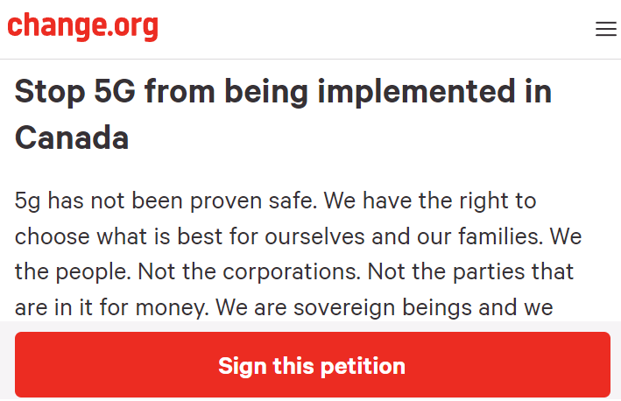
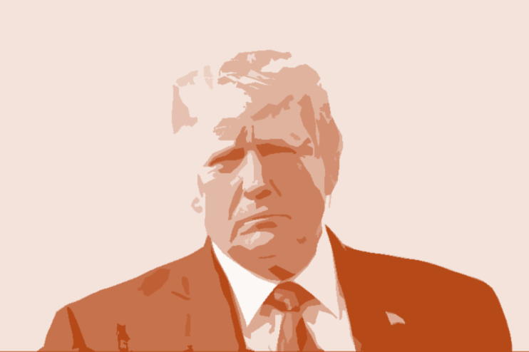
Criticism, skepticism, and distrust of science
Science-related populism
However:
Little evidence that critical attitudes toward science have increased (Motta, 2018)
Critical science attitudes vary across topics, reference
objects, and countries
(Achterberg et al., 2017; Mede, 2022;
Rutjens et al., 2018)
Science criticism can come in various shapes (Mede & Schäfer, 2020)
“I think the people of this country have had enough of experts.”
Mede, N. G., & Schäfer, M. S. (2020). Science-related populism: Conceptualizing populist demands toward science. Public Understanding of Science, 29(5), 473–491. doi: 10.1177/0963662520924259
Protester in Toronto
Michael Gove
“I have a natural instinct for science.”
Petition on change.org
Donald Trump

Slide 19
Conceptualizing science-related populism
Populism
Science-related populism
The elite
“I think the people of this country have had enough of experts.”
illegitimately claims
political
Protester in Toronto
Michael Gove
Decision-making sovereignty
legitimately demands
“I have a natural instinct for science.”
The people
Petition on change.org
(Taggart, 2000)
Donald Trump

Slide 20
Conceptualizing science-related populism
Populism
Science-related populism
The elite
The academic elite
illegitimately claims
illegitimately claims
illegitimately claims
political
science-related
Decision-making sovereignty
Decision-making sovereignty
Truth-speaking sovereignty
legitimately demands
legitimately demands
legitimately demands
The people
The people
(Taggart, 2000)
(Mede & Schäfer, 2020)

Slide 21

Conceptualizing science-related populism
Populism
Science-related populism
The elite
The academic elite
illegitimately claims
illegitimately claims
illegitimately claims
political
science-related
Decision-making sovereignty
Decision-making sovereignty
Truth-speaking sovereignty
legitimately demands
legitimately demands
legitimately demands
The people
The people
rely on common sense
value practical relevance
(Taggart, 2000)
(Mede & Schäfer, 2020)

Slide 22

Conceptualizing science-related populism
Populism
Science-related populism
The elite
The academic elite
scientists, experts, unis
produce useless knowledge
illegitimately claims
illegitimately claims
illegitimately claims
political
science-related
Decision-making sovereignty
Decision-making sovereignty
Truth-speaking sovereignty
legitimately demands
legitimately demands
legitimately demands
The people
The people
(Taggart, 2000)
(Mede & Schäfer, 2020)

Slide 23

Conceptualizing science-related populism
Populism
Science-related populism
The elite
The academic elite
illegitimately claims
illegitimately claims
illegitimately claims
political
science-related
Decision-making sovereignty
Decision-making sovereignty
right to determine research agendas
Truth-speaking sovereignty
legitimately demands
legitimately demands
legitimately demands
The people
The people
(Taggart, 2000)
(Mede & Schäfer, 2020)

Slide 24

Conceptualizing science-related populism
Populism
Science-related populism
The elite
The academic elite
illegitimately claims
illegitimately claims
illegitimately claims
political
science-related
Decision-making sovereignty
Decision-making sovereignty
right to determine “true knowledge”
Truth-speaking sovereignty
legitimately demands
legitimately demands
legitimately demands
The people
The people
(Taggart, 2000)
(Mede & Schäfer, 2020)

Slide 25
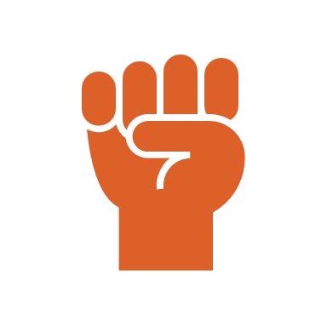

Conceptualizing science-related populism
Populism
Science-related populism
The elite
The academic elite
illegitimately claims
Populist science communication
(“supply side”)
illegitimately claims
illegitimately claims
political
science-related
Decision-making sovereignty
Decision-making sovereignty
Science-related populist attitudes
(“demand side”)
Truth-speaking sovereignty
legitimately demands
legitimately demands
legitimately demands
The people
The people
(Taggart, 2000)
(Mede & Schäfer, 2020)

Slide 26

Conceptualizing science-related populism
Populism
Science-related populism
The elite
The academic elite
illegitimately claims
Populist science communication
(“supply side”)
illegitimately claims
illegitimately claims
political
science-related
Decision-making sovereignty
Decision-making sovereignty
Science-related populist attitudes
(“demand side”)
Truth-speaking sovereignty
legitimately demands
legitimately demands
legitimately demands
The people
The people
(Taggart, 2000)
(Mede & Schäfer, 2020)

Slide 27
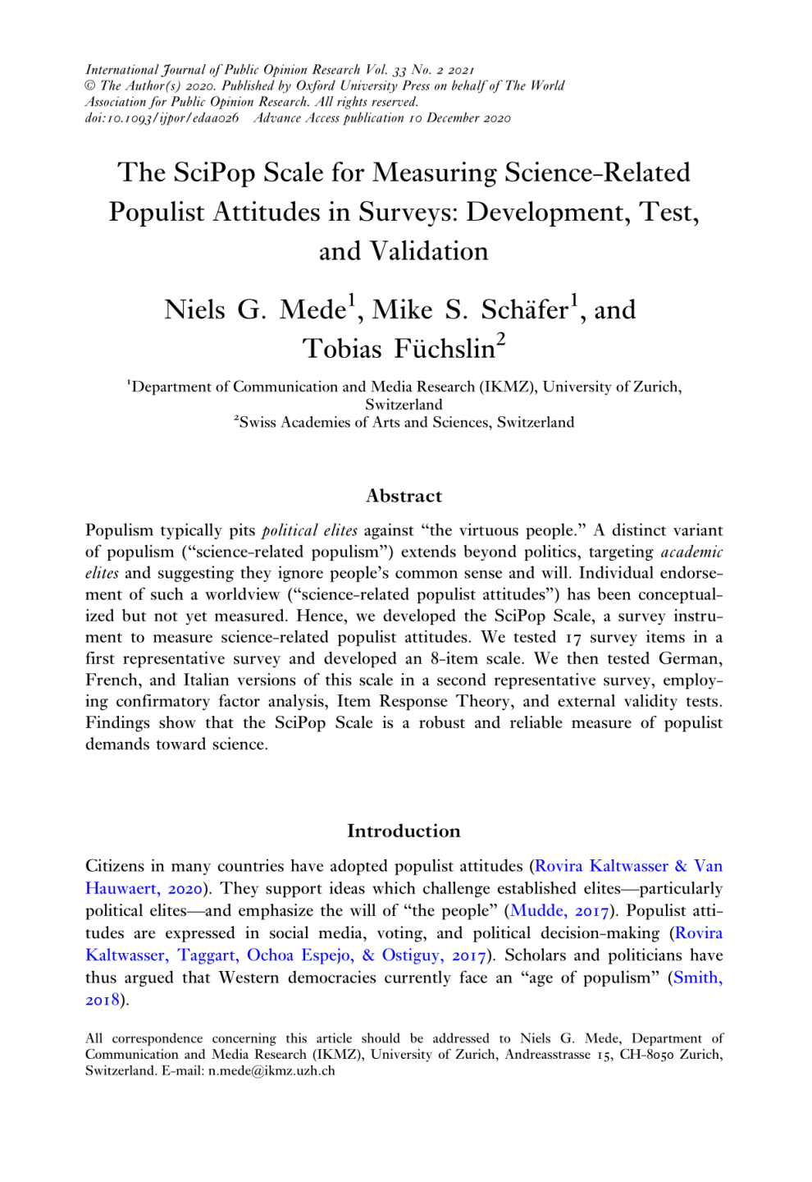
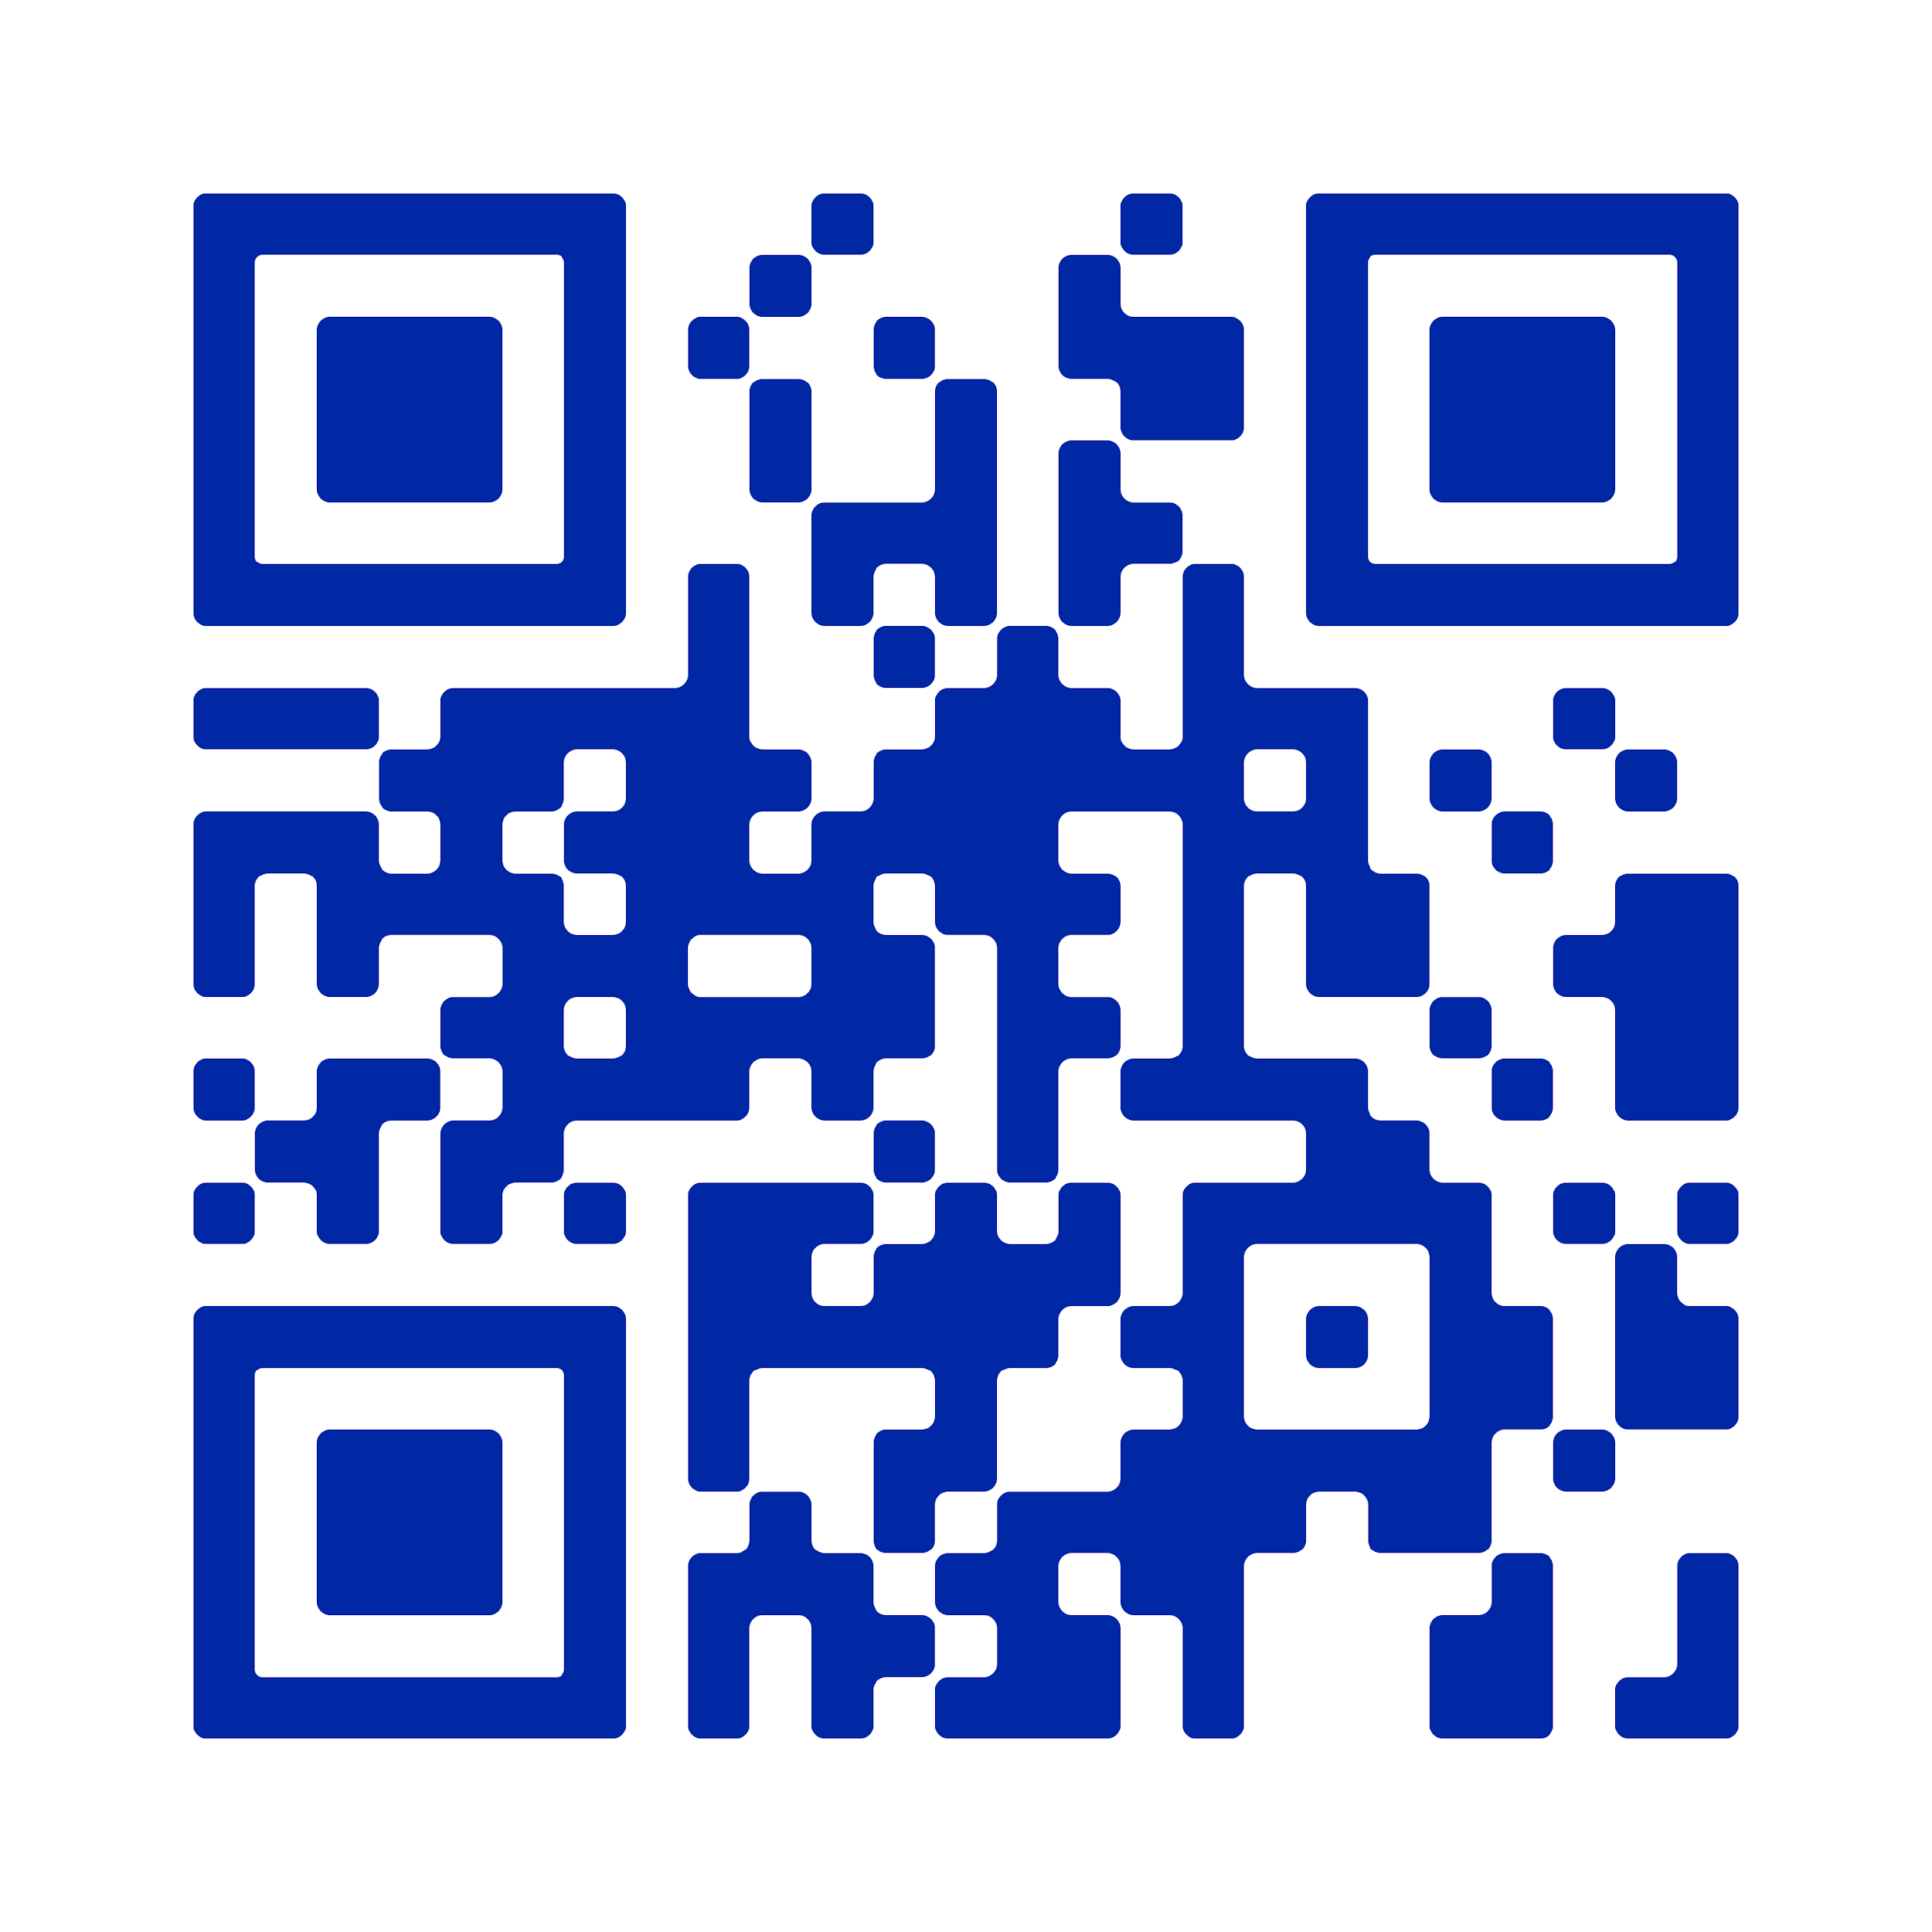
Measurement of science-related populist attitudes (Mede et al., 2021)
Question: How to measure endorsement/rejection of science-related populism in surveys?
Method: Two representative population surveys in German, French, Italian (online/CATI,
2019, Switzerland)
Results:
Science-related populist attitudes can be measured with the SciPop Scale, a robust and reliable 8-item survey scale
Mede, N. G., Schäfer, M. S., & Füchslin, T. (2021). The SciPop Scale for measuring science-related populist attitudes in surveys: Development, test, and validation. International Journal of Public Opinion Research, 33(2), 273–293. doi: 10.1093/ijpor/edaa026

Slide 28
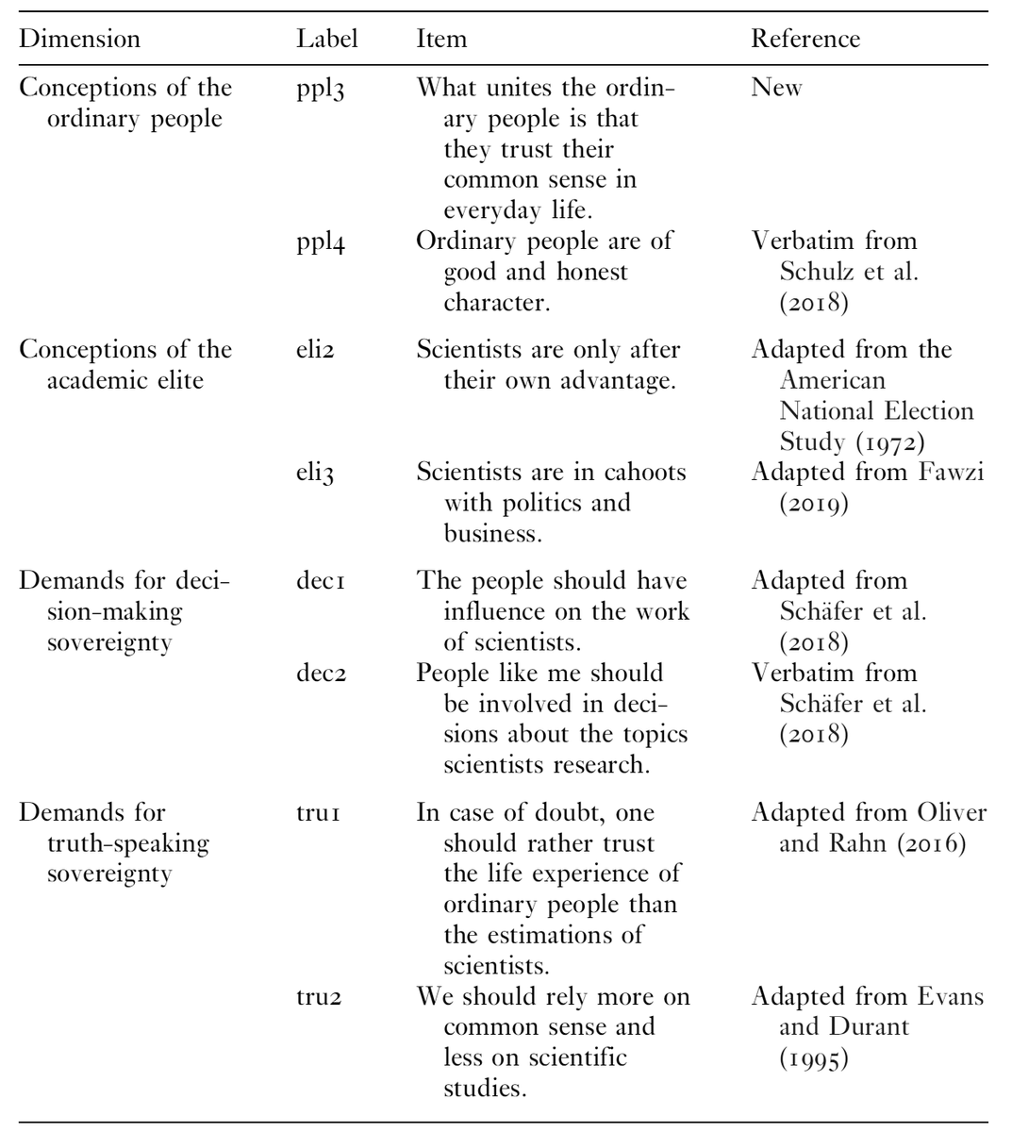
Measurement of science-related populist attitudes (Mede et al., 2021)
Question: How to measure endorsement/rejection of science-related populism in surveys?
Method: Two representative population surveys in German, French, Italian (online/CATI,
2019, Switzerland)
Results:
Science-related populist attitudes can be measured with the SciPop Scale, a robust and reliable 8-item survey scale
Mede, N. G., Schäfer, M. S., & Füchslin, T. (2021). The SciPop Scale for measuring science-related populist attitudes in surveys: Development, test, and validation. International Journal of Public Opinion Research, 33(2), 273–293. doi: 10.1093/ijpor/edaa026

Slide 29
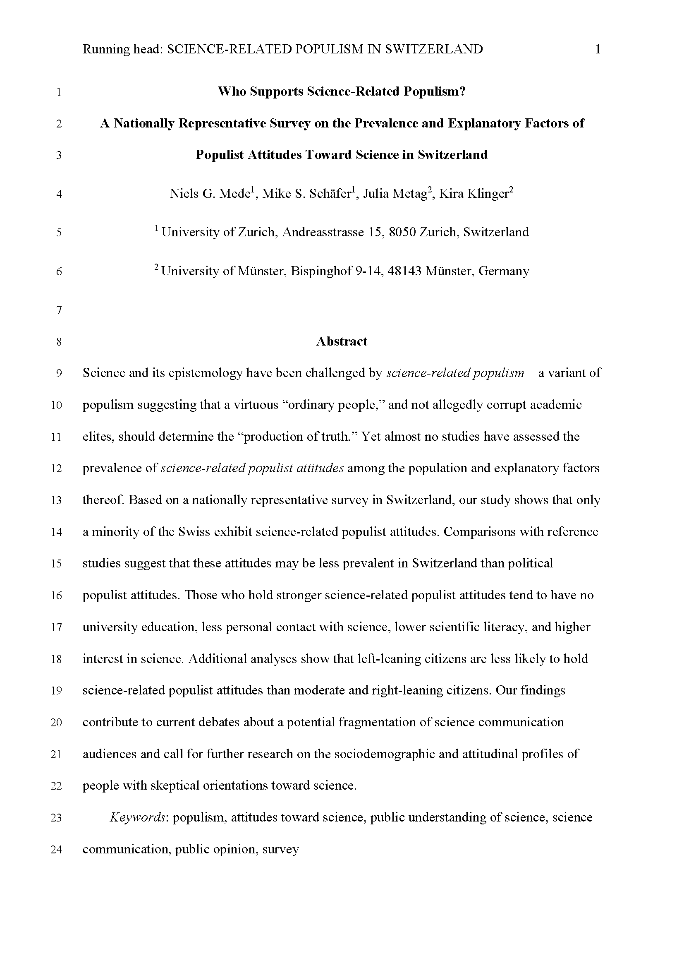
Prevalence and correlates of science-related populist attitudes (Mede et al., under review)
Question: Which sociodemographic and attitudinal milieus are more likely to hold SciPop attitudes?
Method: Representative population survey in German, French, Italian (CATI, Jun 2019, Switzerland)
What we know about science-related populist attitudes:
Science-related populist attitudes can be measured with the SciPop Scale, a robust and reliable 8-item survey scale
SciPop attitudes not very widespread and rather evenly distributed among the Swiss, but more prevalent among specific groups
  low education
  moderate and right-leaning views
  few contact with science, low science literacy
  high interest in science
Mede, N. G., Schäfer, M. S., Metag, J., & Klinger, K. (under review). How prevalent is science-related populism in Switzerland and what explains it? Evidence from a nationally representative survey. 2nd round of review.

Slide 30
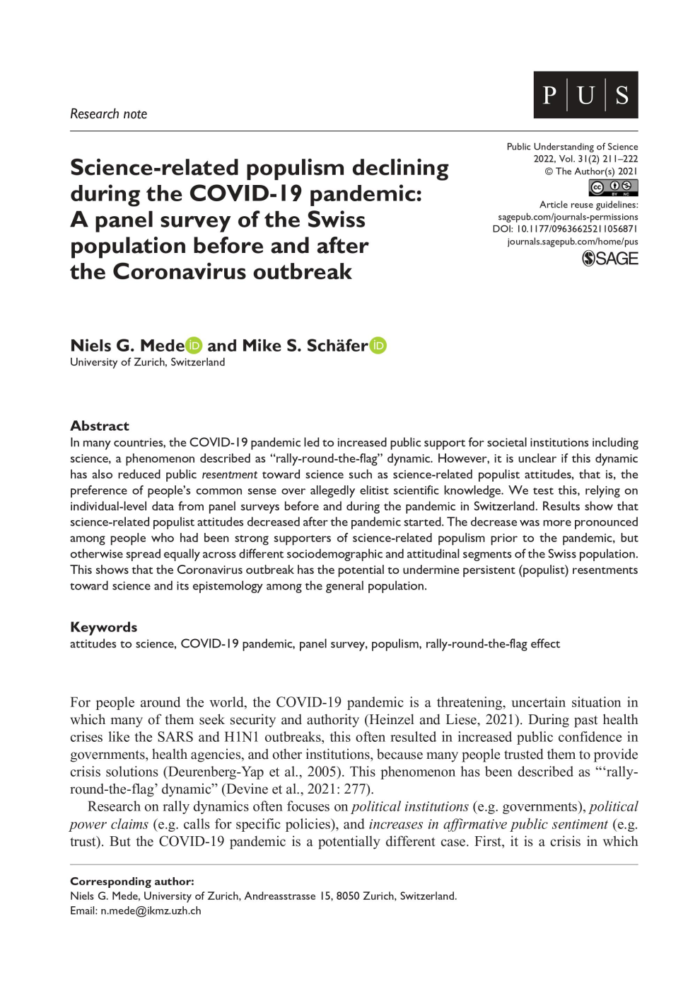
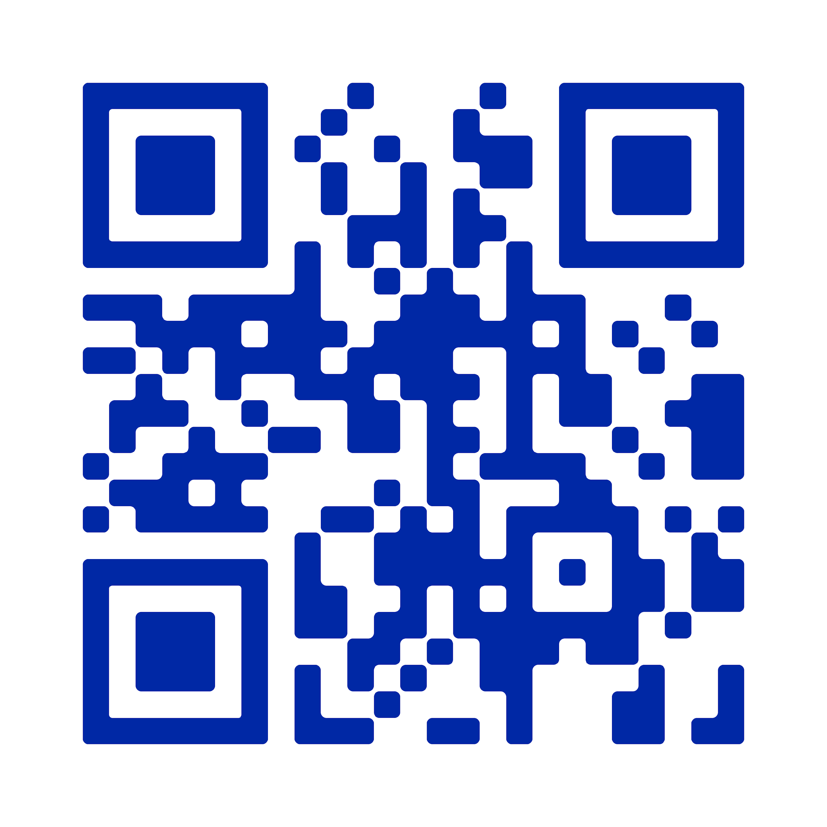
The impact of the COVID-19 pandemic on science-related populism (Mede & Schäfer, 2022)
Question: Did the pandemic tempered SciPop attitudes as people “rallied around” science as an institution?
Method: Panel survey before and during the pandemic (mixed mode, Jun 2019 / Nov 2020, Switzerland)
What we know about science-related populist attitudes:
Science-related populist attitudes can be measured with the SciPop Scale, a robust and reliable 8-item survey scale
SciPop attitudes not very widespread and rather evenly distributed among the Swiss, but more prevalent among specific groups
The pandemic has (initially) driven a “science-related rally-round-the-flag” in Switzerland
  decline of SciPop attitudes among Swiss public
  decline stronger among avid SciPop supporters, otherwise spread rather equally
Mede, N. G., & Schäfer, M. S. (2022). Science-related populism declining during the COVID-19 pandemic: A panel survey of the Swiss population before and after the coronavirus outbreak. Public Understanding of Science, 31(2), 211–222. https://doi.org/10.1177/09636625211056871

Slide 31
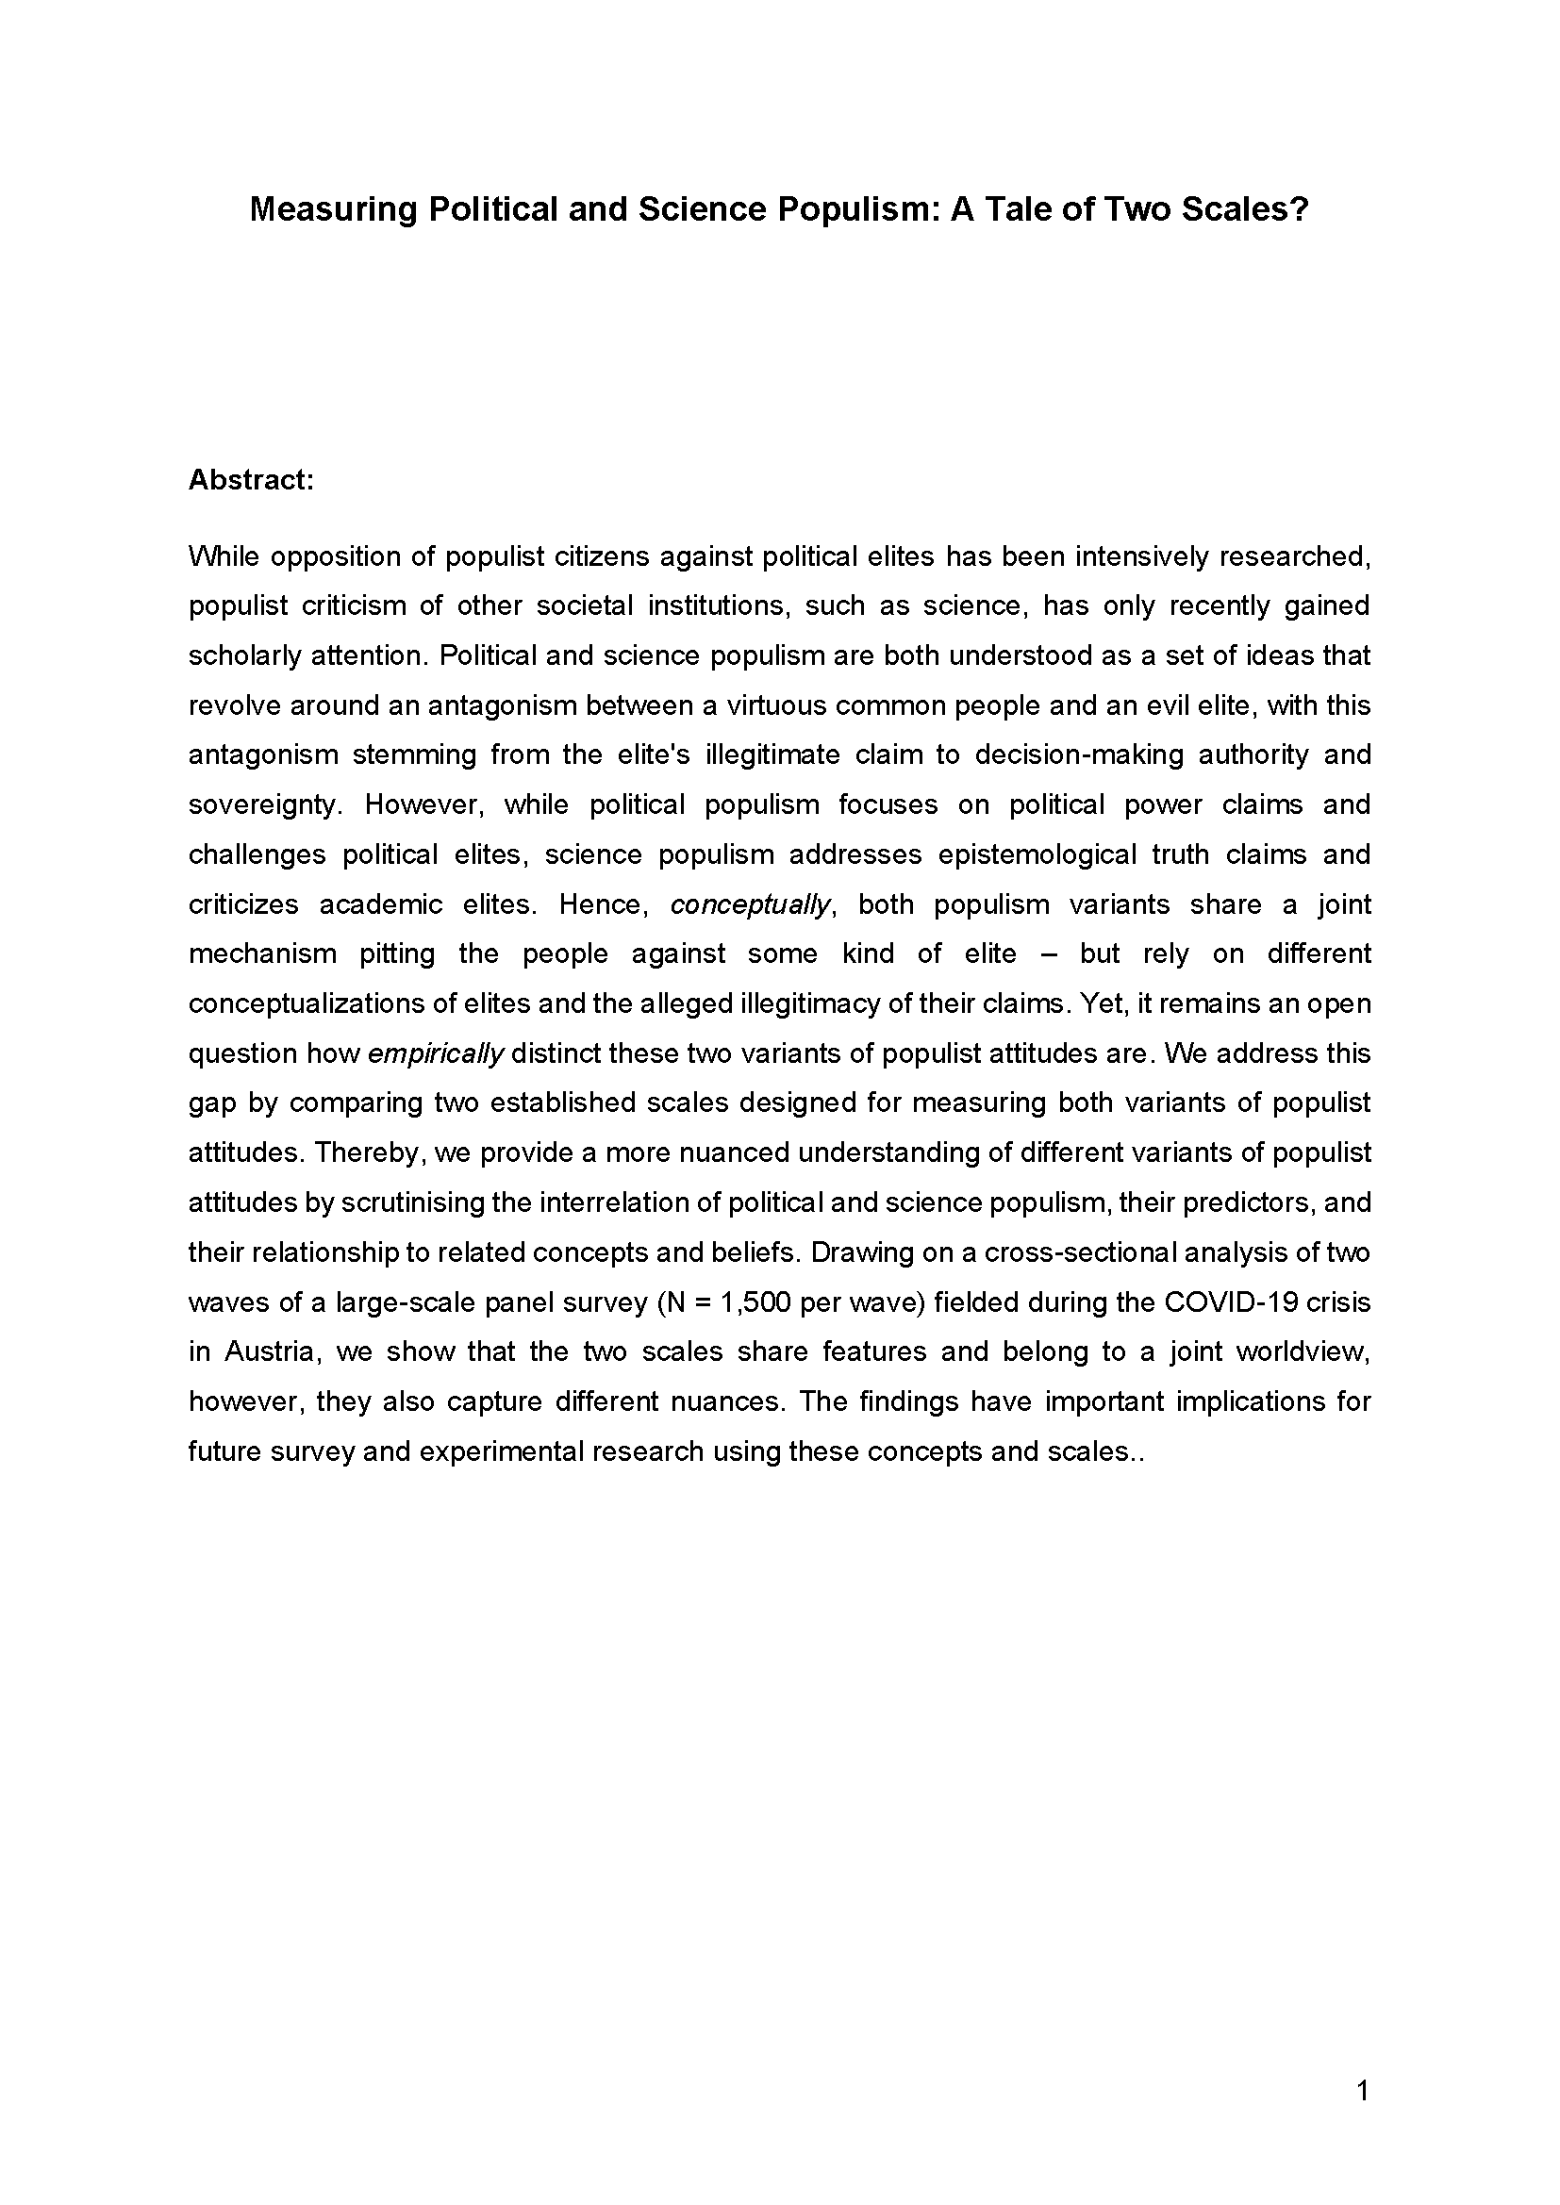
Science-related populism vis-à-vis political populism (Eberl et al., under review)
Question: What are similarities and differences between science-related and political populist attitudes?
Method: Representative panel survey (online, Feb / Mar 2021, Austria)
What we know about science-related populist attitudes:
Science-related populist attitudes can be measured with the SciPop Scale, a robust and reliable 8-item survey scale
SciPop attitudes not very widespread and rather evenly distributed among the Swiss, but more prevalent among specific groups
The pandemic has (initially) driven a “science-related rally-round-the-flag” in Switzerland
PolPop and SciPop attitudes
  distinct: separate latent factors, no cross-loadings
  overlaps: similar relationships with income, education, political interest
  different correlates: trust in government/science, technocratic attitudes, COVID-19 conspiracy beliefs
Huber, R. A., Eberl, J.-M., Mede, N. G., & Greussing, E. (under review). Measuring political and science populism: A tale of two scales? 1st round of review.

Slide 32
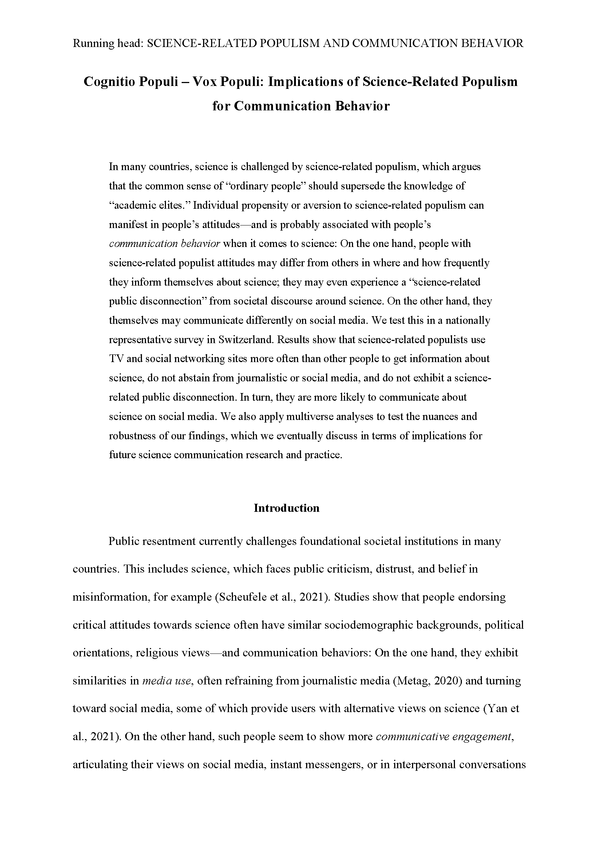
Communication behavior of science-related populists (Mede, Schäfer, & Metag, under review)
Question: How do science-related populists inform themselves and communicate about science?
Method: Representative population survey in German, French, and Italian (CATI, Jun 2019, Switzerland)
What we know about science-related populist attitudes:
Science-related populist attitudes can be measured with the SciPop Scale, a robust and reliable 8-item survey scale
SciPop attitudes not very widespread and rather evenly distributed among the Swiss, but more prevalent among specific groups
The pandemic has (initially) driven a “science-related rally-round-the-flag” in Switzerland
PolPop and SciPop attitudes
SciPops exhibit distinct communication behavior
  rely more on TV and social networking sites
  to get info on science
  avoid visiting museums
  comment more often on social media
Mede, N. G., Schäfer, M. S., & Metag, J. (under review). Cognitio populi — vox populi: Implications of science-related populism for communication behavior. 1st round of review.

Slide 33
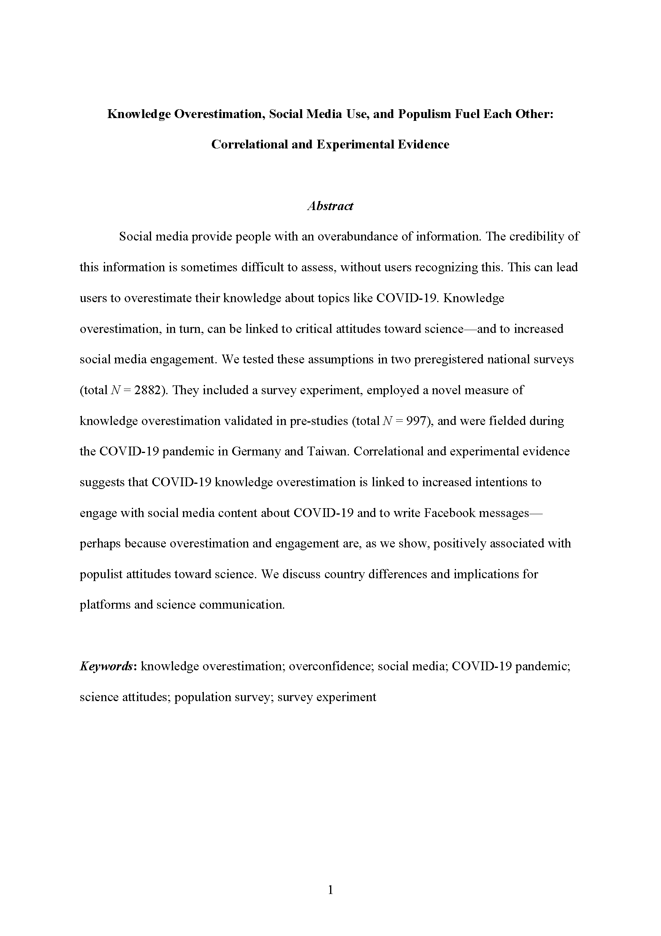
Science-related populism, overconfidence, and social media use (Mede et al., under review)
Question: Do knowledge overestimation, science-related populism, and digital media use reinforce each other?
Method: Two surveys + two quota-sampled survey experiments (online, May / Nov 2020, Germany and Taiwan)
What we know about science-related populist attitudes:
Science-related populist attitudes can be measured with the SciPop Scale, a robust and reliable 8-item survey scale
SciPop attitudes not very widespread and rather evenly distributed among the Swiss, but more prevalent among specific groups
The pandemic has (initially) driven a “science-related rally-round-the-flag” in Switzerland
PolPop and SciPop attitudes
SciPops exhibit distinct communication behavior
COVID-19 knowledge overestimation
  linked to higher use of digital media
  exacerbated by SciPop attitudes
  drives engagement with COVID-19-related content in instant messengers and social media
Mede, N. G., Rauchfleisch, A., Metag, J., & Schäfer, M. S. (under review). Knowledge overestimation, social media use, and populism fuel each other: Correlational and experimental evidence. 1st round of review.

Slide 34
Trust in science and science-related populism: a global assessment

Slide 35
Trust in science and science-related populism: a global assessment
WHAT?
First international study to provide a global assessment of predictors of trust and distrust in science and science-related populism

Slide 36
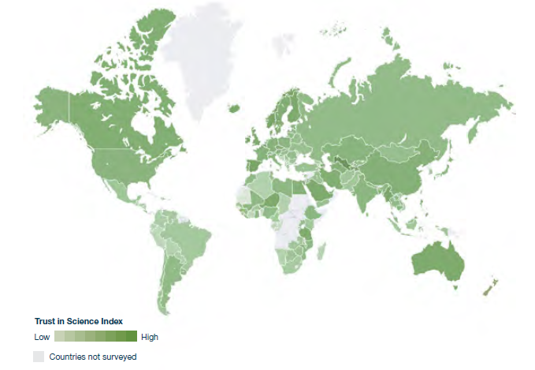
Trust in science and science-related populism: a global assessment
WHY?
Critical science attitudes vary across countries (Mede, 2022)
Existing global surveys have several limitations
Wellcome Global Monitor (2022)

Slide 37
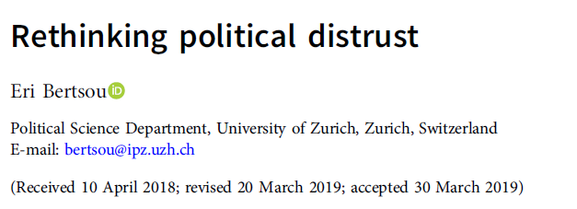
Trust in science and science-related populism: a global assessment
WHY?
Critical science attitudes vary across countries (Mede, 2022)
Existing global surveys have several limitations:
Only assess trust but not distrust in science
Notes:
Conflating distrust with the lack of trust is inaccurate and problematic, both conceptually and empirically. The lack of trust is the opposite of trust. Similarly, lack of distrust is the opposite of distrust.
Absence of benefit does not imply cost.
Studies find that trust and distrust are two different constructs.

Slide 38
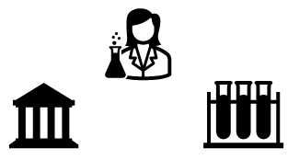
Trust in science and science-related populism: a global assessment
WHY?
Critical science attitudes vary across countries (Mede, 2022)
Existing global surveys have several limitations:
Only assess trust but not distrust in science
Trust in science as a one-dimensional construct
Notes:
Achterberg et al. (2014) find that some people place great trust in scientific methods and principles, but simultaneously distrust scientific institutions.

Slide 39
Trust in science and science-related populism: a global assessment
WHY?
Critical science attitudes vary across countries (Mede, 2022)
Existing global surveys have several limitations:
Only assess trust but not distrust in science
Trust in science as a one-dimensional construct
Rarely investigate (psychological) predictors of trust in science
Notes:
Achterberg et al. (2014) find that some people place great trust in scientific methods and principles, but simultaneously distrust scientific institutions.

Slide 40
Trust in science and science-related populism: a global assessment
WHY?
Critical science attitudes vary across countries (Mede, 2022)
Existing global surveys have several limitations:
Only assess trust but not distrust in science
Trust in science as a one-dimensional construct
Rarely investigate (psychological) predictors of trust in science
Science-related populism has not been investigated in a global context
Notes:
Achterberg et al. (2014) find that some people place great trust in scientific methods and principles, but simultaneously distrust scientific institutions.

Slide 41
Trust in science and science-related populism: a global assessment
WHY?
Critical science attitudes vary across countries (Mede, 2022)
Existing global surveys have several limitations:
Only assess trust but not distrust in science
Trust in science as a one-dimensional construct
Rarely investigate (psychological) predictors of trust in science
Science-related populism has not been investigated in a global context
Often focus on Western countries
Notes:
Achterberg et al. (2014) find that some people place great trust in scientific methods and principles, but simultaneously distrust scientific institutions.

Slide 42
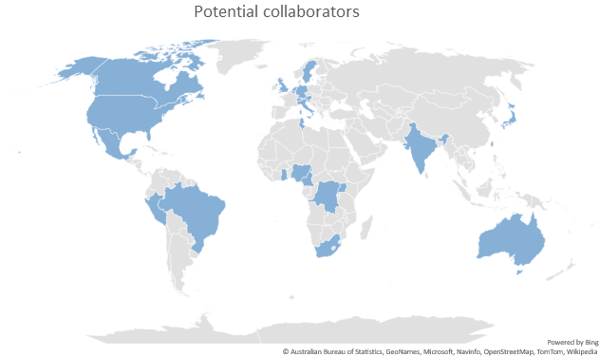
HOW?
Many Labs Study
Call for participation to be launched
in May
Goal: to collect data from over 20 countries

Slide 43

Survey content
Trust and distrust in the scientific community, scientists and the scientific method
Credibility of national versus Western scientists
Science in society and policy-making
Goal(s) of science
Perceived benefits of science
Science-related populist attitudes
Media use (“intake”)
Communication about science (“outreach”)
Resilience toward anti-scientific ideas and misinformation
Psychological predictors (e.g., social dominance orientation)

Slide 44
Survey content
Trust and distrust in the scientific community, scientists and the scientific method
Credibility of national versus Western scientists
Science in society and policy-making
Goal(s) of science
Perceived benefits of science
Science-related populist attitudes
Media use (“intake”)
Communication about science (“outreach”)
Resilience toward anti-scientific ideas and misinformation
Psychological predictors (e.g., social dominance orientation)

Slide 45
Survey content
Trust and distrust in the scientific community, scientists and the scientific method
Credibility of national versus Western scientists
Science in society and policy-making
Goal(s) of science
Perceived benefits of science
Science-related populist attitudes
Media use (“intake”)
Communication about science (“outreach”)
Resilience toward anti-scientific ideas and misinformation
Psychological predictors (e.g., social dominance orientation)

Slide 46
Survey content
Trust and distrust in the scientific community, scientists and the scientific method
Credibility of national versus Western scientists
Science in society and policy-making
Goal(s) of science
Perceived benefits of science
Science-related populist attitudes
Media use (“intake”)
Communication about science (“outreach”)
Resilience toward anti-scientific ideas and misinformation
Psychological predictors (e.g., social dominance orientation)

Slide 47
Survey content
Trust and distrust in the scientific community, scientists and the scientific method
Credibility of national versus Western scientists
Science in society and policy-making
Goal(s) of science
Perceived benefits of science
Science-related populist attitudes
Media use (“intake”)
Communication about science (“outreach”)
Resilience toward anti-scientific ideas and misinformation
Psychological predictors (e.g., social dominance orientation)

Slide 48
Survey content
Trust and distrust in the scientific community, scientists and the scientific method
Credibility of national versus Western scientists
Science in society and policy-making
Goal(s) of science
Perceived benefits of science
Science-related populist attitudes
Media use (“intake”)
Communication about science (“outreach”)
Resilience toward anti-scientific ideas and misinformation
Psychological predictors (e.g., social dominance orientation)

Slide 49
Survey content
Trust and distrust in the scientific community, scientists and the scientific method
Credibility of national versus Western scientists
Science in society and policy-making
Goal(s) of science
Perceived benefits of science
Science-related populist attitudes
Media use (“intake”)
Communication about science (“outreach”)
Resilience toward anti-scientific ideas and misinformation
Psychological predictors (e.g., social dominance orientation)

Slide 50
Survey content
Trust and distrust in the scientific community, scientists and the scientific method
Credibility of national versus Western scientists
Science in society and policy-making
Goal(s) of science
Perceived benefits of science
Science-related populist attitudes
Media use (“intake”)
Communication about science (“outreach”)
Resilience toward anti-scientific ideas and misinformation
Psychological predictors (e.g., social dominance orientation)

Slide 51
Survey content
Trust and distrust in the scientific community, scientists and the scientific method
Credibility of national versus Western scientists
Science in society and policy-making
Goal(s) of science
Perceived benefits of science
Science-related populist attitudes
Media use (“intake”)
Communication about science (“outreach”)
Resilience toward anti-scientific ideas and misinformation
Psychological predictors (e.g., social dominance orientation)

Slide 52
Survey content
Trust and distrust in the scientific community, scientists and the scientific method
Credibility of national versus Western scientists
Science in society and policy-making
Goal(s) of science
Perceived benefits of science
Science-related populist attitudes
Media use (“intake”)
Communication about science (“outreach”)
Resilience toward anti-scientific ideas and misinformation
Psychological predictors (e.g., social dominance orientation)

Slide 53
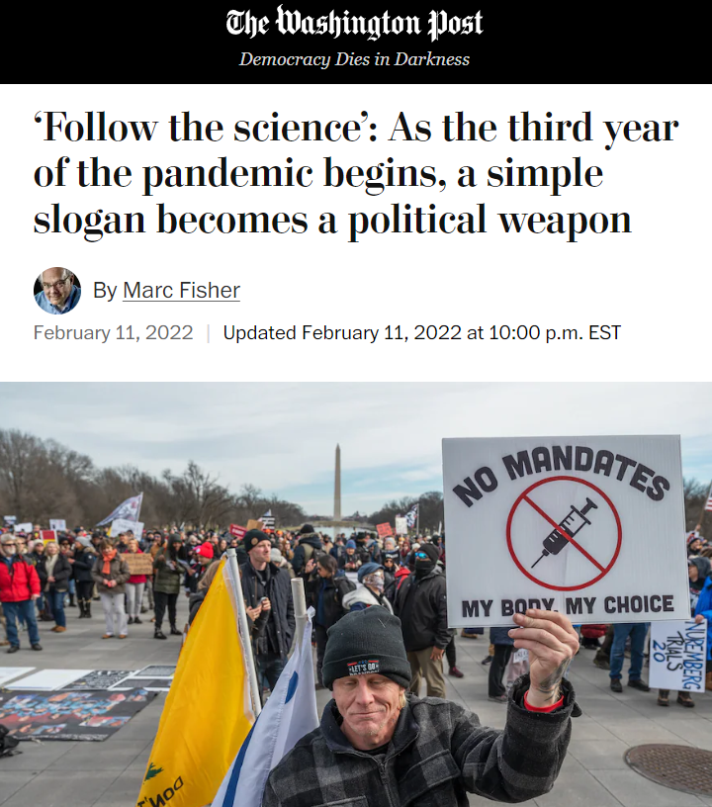
Trust and populism: Implications for the role of science in policy-making
Legitimacy of political decisions undermined if they are based on scientific knowledge that is perceived as unreliable, useless, and ideologically biased
Externalizing political decisions to experts politicizes science even more
  debates about science shift from questions of epistemologically right vs wrong to questions of morally right vs wrong
  this can reduce capacity of science to be a widely accepted provider of “the best available knowledge”
If public distrust experts, politicians relying on them may suffer from this, losing trustworthiness as well → how to avoid this?
If public trusts experts, politicians relying on them may profit from this, gaining trustworthiness as well → how to reach this?

Slide 54
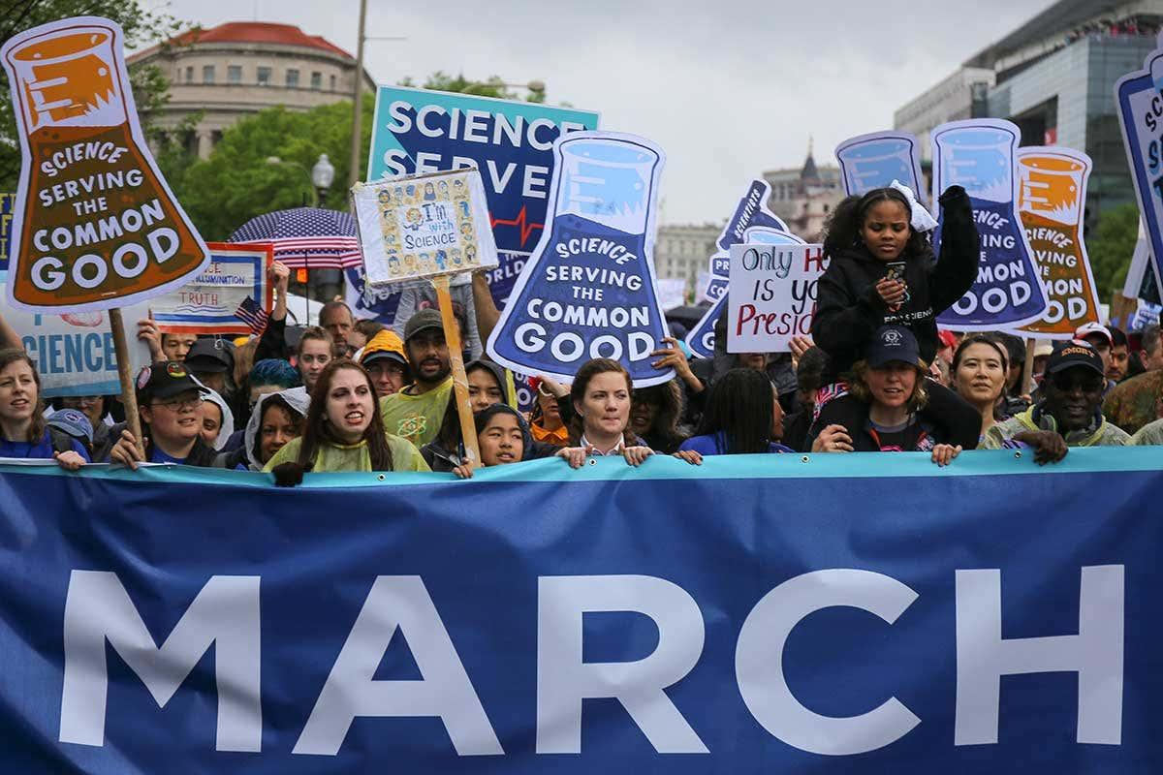
Trust and populism: How to establish the former and challenge the latter?
Scientists, politicians and science communicators must consider broader societal contexts of their actions (see Scheufele, 2013)
Interventions: inoculation, pre/debunking, etc. (see Ecker et al., 2022)
Empower publics to be aware of how political values shape their attitudes toward science (see Howell & Brossard, 2021)
Proactive measures by scientists: advocacy, March for Science, etc. (see Drążkiewicz Grodzicka & Harambam, 2021)

Slide 55
Trust and populism: How to establish the former and challenge the latter?
Scientists, politicians and science communicators must consider broader societal contexts of their actions (see Scheufele, 2013)
Interventions: inoculation, pre/debunking, etc. (see Ecker et al., 2022)
Empower publics to be aware of how political values shape their attitudes toward science (see Howell & Brossard, 2021)
Proactive measures by scientists: advocacy, March for Science, etc. (see Drążkiewicz Grodzicka & Harambam, 2021)
However:
Interventions may not work or even backfire, e.g., due to partisan reasoning (Merkley, 2020; Nyhan & Reifler, 2010)
Partisan reasoning hard to challenge (Hart & Nisbet, 2012)
Scientific advocacy may be perceived as elitist, thus triggering those (populist) sentiments that it aims to reduce (Motta, 2018)

Slide 56
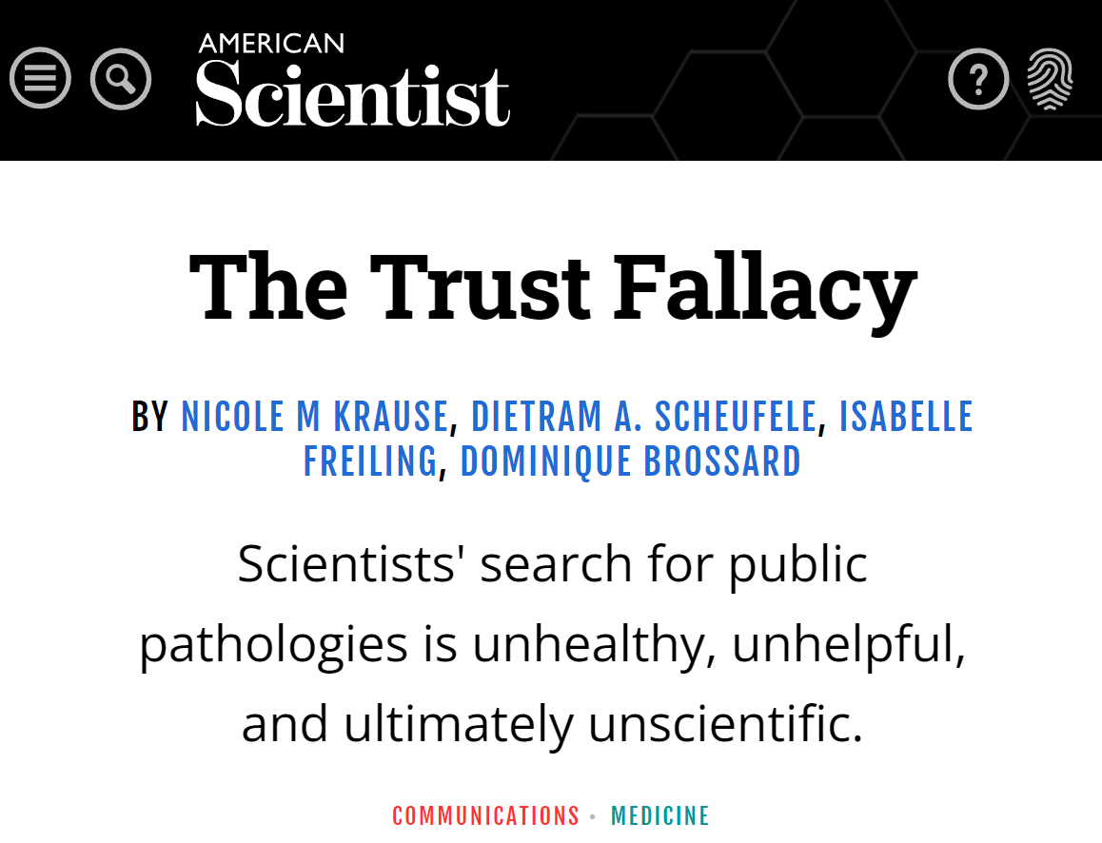
Prevalent but flawed assumptions about the audiences of science and politics
Publics are not monolithic – there are different segments, nuances, etc. (Besley, 2018)
Publics are not passive – there is agency, bottom-up action, etc. (McAdam, 2017)
Publics are not to be pathologized – they are not per se skeptical laypeople who inevitably challenge politics/science (Krause et al. 2021)

Slide 57

Thank you for your attention!
viktoriacologna@fas.harvard.edu
n.mede@ikmz.uzh.ch
@colognav
@nielsmede

Slide 58
References
Achterberg, P., Koster, W. de, & van der Waal, J. (2017). A science confidence gap: Education, trust in scientific methods, and trust in scientific institutions in the United States, 2014. Public Understanding of Science, 26(6), 704–720. https://doi.org/10.1177/0963662515617367
Bertsou, E., & Caramani, D. (2022). People haven't had enough of experts: Technocratic attitudes among citizens in nine European democracies. American Journal of Political Science, 66(1), 5–23. https://doi.org/10.1111/ajps.12554
Besley, J. C. (2018). Audiences for science communication in the United States. Environmental Communication, 12(8), 1005–1022. https://doi.org/10.1080/17524032.2018.1457067
Cologna, V., Bark, R. H., & Paavola, J. (2017). Flood risk perceptions and the UK media: Moving beyond “once in a lifetime” to “Be Prepared” reporting. Climate Risk Management, 17, 1–10. https://doi.org/10.1016/j.crm.2017.04.005
Cologna, V., & Siegrist, M. (2020). The role of trust for climate change mitigation and adaptation behaviour: A meta-analysis. Journal of Environmental Psychology, 69, 101428. https://doi.org/10.1016/j.jenvp.2020.101428
Cologna, V., Hoogendoorn, G., & Brick, C. (2021). To strike or not to strike? An investigation of the determinants of strike participation at the Fridays for Future climate strikes in Switzerland. PLOS ONE, 16(10), e0257296. https://doi.org/10.1371/journal.pone.0257296
Cologna, V., Knutti, R., Oreskes, N., & Siegrist, M. (2021). Majority of German citizens, US citizens and climate scientists support policy advocacy by climate researchers and expect greater political engagement. Environmental Research Letters, 16(2), 024011. https://doi.org/10.1088/1748-9326/abd4ac
Cologna, V., Berthold, A., & Siegrist, M. (2022). Knowledge, perceived potential and trust as determinants of low- and high-impact pro-environmental behaviours. Journal of Environmental Psychology, 79, 101741. https://doi.org/10.1016/j.jenvp.2021.101741
Drążkiewicz Grodzicka, E., & Harambam, J. (2021). What should academics do about conspiracy theories? Moving beyond debunking to better deal with conspiratorial movements, misinformation and post-truth. Journal for Cultural Research, 25(1). https://doi.org/10.1080/14797585.2021.1886420
Earle, T. C. (2010). Trust in Risk Management: A Model-Based Review of Empirical Research. Risk Analysis, 30(4), 541–574. https://doi.org/10.1111/j.1539-6924.2010.01398.x
Earle, T. C., Siegrist, M., & Gutscher, H. (2007). Trust, risk perception and the TCC model of cooperation. In M. Siegrist, T. C. Earle, & H. Gutscher (Eds.), Trust in cooperative risk management: Uncertainty and scepticism in the public mind (pp. 1–49). Earthscan.
Ecker, U. K. H., Lewandowsky, S., Cook, J., Schmid, P., Fazio, L. K., Brashier, N., Kendeou, P., Vraga, E. K., & Amazeen, M. A. (2022). The psychological drivers of misinformation belief and its resistance to correction. Nature Reviews Psychology, 1(1), 13–29. https://doi.org/10.1038/s44159-021-00006-y
Elchardus, M., & Spruyt, B. (2016). Populism, persistent republicanism and declinism: An empirical analysis of populism as a thin ideology. Government and Opposition, 51(1), 111–133. https://doi.org/10.1017/gov.2014.27
Funk, C., & Kennedy, B. (2020, October 27). Public confidence in scientists has remained stable for decades. Pew Research Center. https://www.pewresearch.org/fact-tank/2020/08/27/public-confidence-in-scientists-has-remained-stable-for-decades/

Slide 59
References
Goodwin, J., & Dahlstrom, M. F. (2014). Communication strategies for earning trust in climate change debates. Wiley Interdisciplinary Reviews: Climate Change, 5(1), 151–160. https://doi.org/10.1002/wcc.262
Luhmann, N. (1989). Vertrauen. Ein Mechanismus der Reduktion sozialer Komplexität. Enke.
Hart, P. S., & Nisbet, E. C. (2012). Boomerang effects in science communication: How motivated reasoning and identity cues amplify opinion polarization about climate mitigation policies. Communication Research, 39(6), 701–723. https://doi.org/10.1177/0093650211416646
Howell, E. L., & Brossard, D. (2021). (Mis)informed about what? What it means to be a science-literate citizen in a digital world. Proceedings of the National Academy of Sciences, 118(15), e1912436117. https://doi.org/10.1073/pnas.1912436117
Huber, R. A., Eberl, J.-M., Mede, N. G., & Greussing, E. (under review). Measuring political and science populism: A tale of two scales? 1st round of review.
Krause, N., Scheufele, D., Freiling, I., & Brossard, D. (2021). The trust fallacy. American Scientist, 109(4), 226–231. https://doi.org/10.1511/2021.109.4.226
McAdam, D. (2017). Social movement theory and the prospects for climate change activism in the United States. Annual Review of Political Science, 20(1), 189–208. https://doi.org/10.1146/annurev-polisci-052615-025801
Mede, N. G. (2022). Legacy media as inhibitors and drivers of public reservations against science: Global survey evidence on the link between media use and anti-science attitudes. Humanities and Social Sciences Communications. Advance online publication. https://doi.org/10.1057/s41599-022-01058-y
Mede, N. G., Rauchfleisch, A., Metag, J., & Schäfer, M. S. (under review). Knowledge overestimation, social media use, and populism fuel each other: Correlational and experimental evidence. 1st round of review.
Mede, N. G., & Schäfer, M. S. (2020). Science-related populism: Conceptualizing populist demands toward science. Public Understanding of Science, 29(5), 473–491. https://doi.org/10.1177/0963662520924259
Mede, N. G., & Schäfer, M. S. (2022). Science-related populism declining during the COVID-19 pandemic: A panel survey of the Swiss population before and after the coronavirus outbreak. Public Understanding of Science, 31(2), 211–222. https://doi.org/10.1177/09636625211056871
Mede, N. G., Schäfer, M. S., & Füchslin, T. (2021). The SciPop Scale for measuring science-related populist attitudes in surveys: Development, test, and validation. International Journal of Public Opinion Research, 33(2), 273–293. https://doi.org/10.1093/ijpor/edaa026
Mede, N. G., Schäfer, M. S., & Metag, J. (under review). Cognitio populi — vox populi: Implications of science-related populism for communication behavior. 1st round of review.
Mede, N. G., Schäfer, M. S., Metag, J., & Klinger, K. (under review). How prevalent is science-related populism in Switzerland and what explains it? Evidence from a nationally representative survey. 2nd round of review.
Merkley, E. (2020). Anti-intellectualism, populism, and motivated resistance to expert consensus. Public Opinion Quarterly, 81(1), 24–48. https://doi.org/10.1093/poq/nfz053

Slide 60
References
Motta, M. (2018). The polarizing effect of the March for Science on attitudes toward scientists. PS: Political Science & Politics, 51(4), 782–788. https://doi.org/10.1017/S1049096518000938
Nisbet, M. C., & Scheufele, D. A. (2009). What's next for science communication? Promising directions and lingering distractions. American Journal of Botany, 96(10), 1767–1778. https://doi.org/10.3732/ajb.0900041
Nyhan, B., & Reifler, J. (2010). When corrections fail: The persistence of political misperceptions. Political Behavior, 32(2), 303–330. https://doi.org/10.1007/s11109-010-9112-2
Oliver, J. E., & Wood, T. (2018). Enchanted America: How intuition and reason divide our politics. University of Chicago Press.
Rousseau, D. M., Sitkin, S. B., Burt, R. S., & Camerer, C. (1998). Not So Different After All: A Cross-Discipline View Of Trust. Academy of Management Review, 23(3), 393–404. https://doi.org/10.5465/amr.1998.926617
Rutjens, B. T., Sutton, R. M., & van der Lee, R. (2018). Not all skepticism is equal: Exploring the ideological antecedents of science acceptance and rejection. Personality and Social Psychology Bulletin, 44(3), 384–405. https://doi.org/10.1177/0146167217741314
Science Barometer Germany (2019). Results of the Science Barometer Germany 2019. https://www.wissenschaft-im-dialog.de/en/our-projects/science-barometer/science-barometer-2019/
Scheufele, D. A. (2013). Communicating science in social settings. Proceedings of the National Academy of Sciences, 110 Suppl 3, 14040–14047. https://doi.org/10.1073/pnas.1213275110
Scheufele, D. A., Krause, N. M., & Freiling, I. (2021). Misinformed about the “infodemic?” Science’s ongoing struggle with misinformation. Journal of Applied Research in Memory and Cognition, 10(4), 522–526. https://doi.org/10.1016/j.jarmac.2021.10.009
Siegrist, M. (2021). Trust and Risk Perception: A Critical Review of the Literature. Risk Analysis, 41(3), 480–490. https://doi.org/10.1111/risa.13325
Taggart, P. (2000). Populism. Open University Press.
Visschers, V. H. M., Keller, C., & Siegrist, M. (2011). Climate change benefits and energy supply benefits as determinants of acceptance of nuclear power stations: Investigating an explanatory model. Energy Policy, 39(6), 3621–3629. https://doi.org/10.1016/j.enpol.2011.03.064

